Slide 1

PRODUCTIVITY
Assignment 1

Slide 2
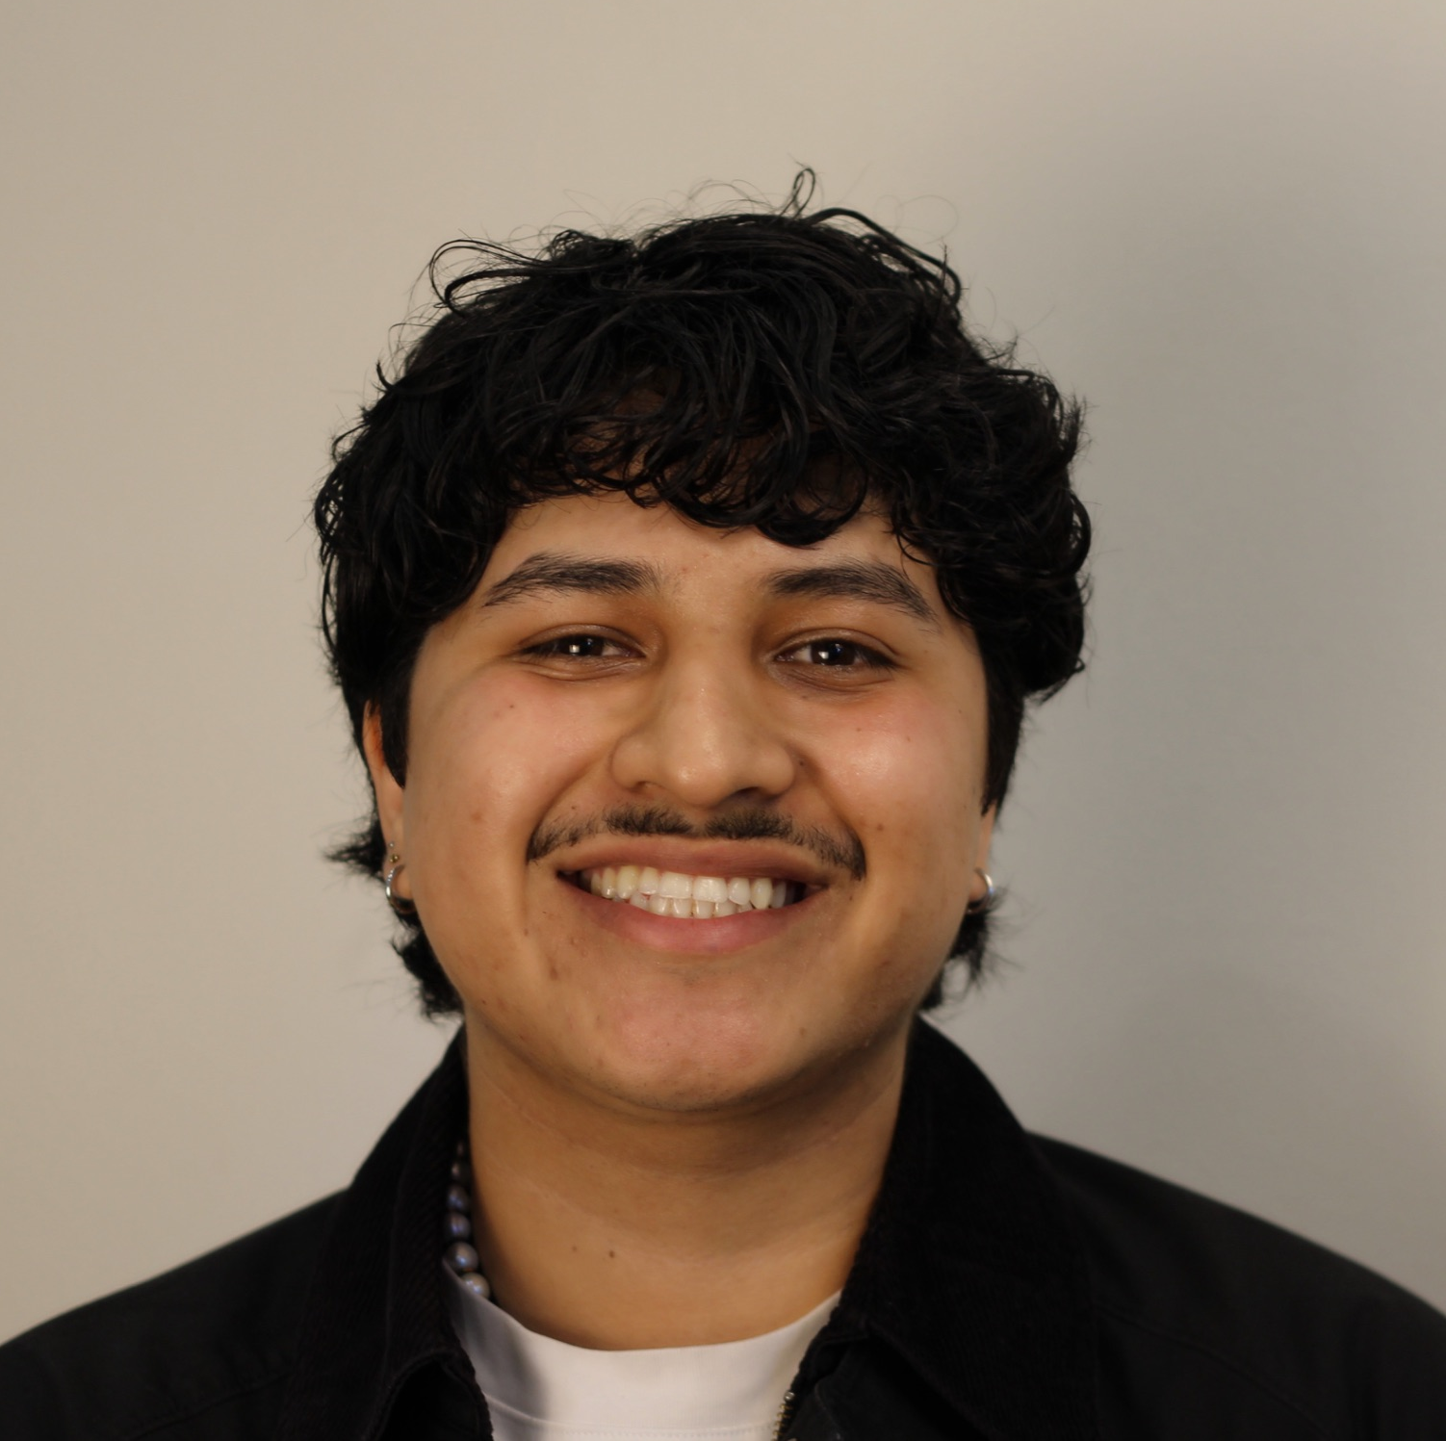


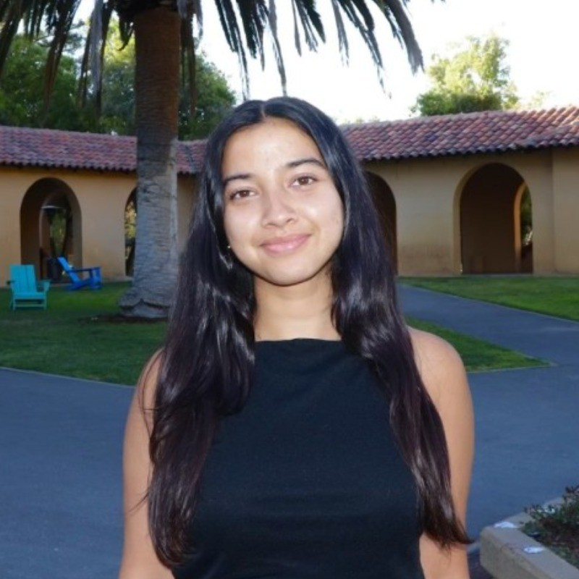
OUR TEAM
Gil S.
Bennie N.
Gabriella U.
Amesha B.

Slide 3
Pressure to always appear “productive”
General lack of focus + willingness to do things that that grit
Social Media
Connection
Can people answer the question “what do you do in your free time”?
Effects of Productivity Overload on Mental Wellbeing
Time management or the lack thereof
Unpacking the need to be overstimulated
Introspection
Supporting executive function across neurodiversities
Baseline Wellbeing
DOMAIN SELECTION
Notes:
Looked at things we’re interested in separately
Looked over everyone elses, picked out what we liked
Came to productivity bc well-rounded

Slide 4
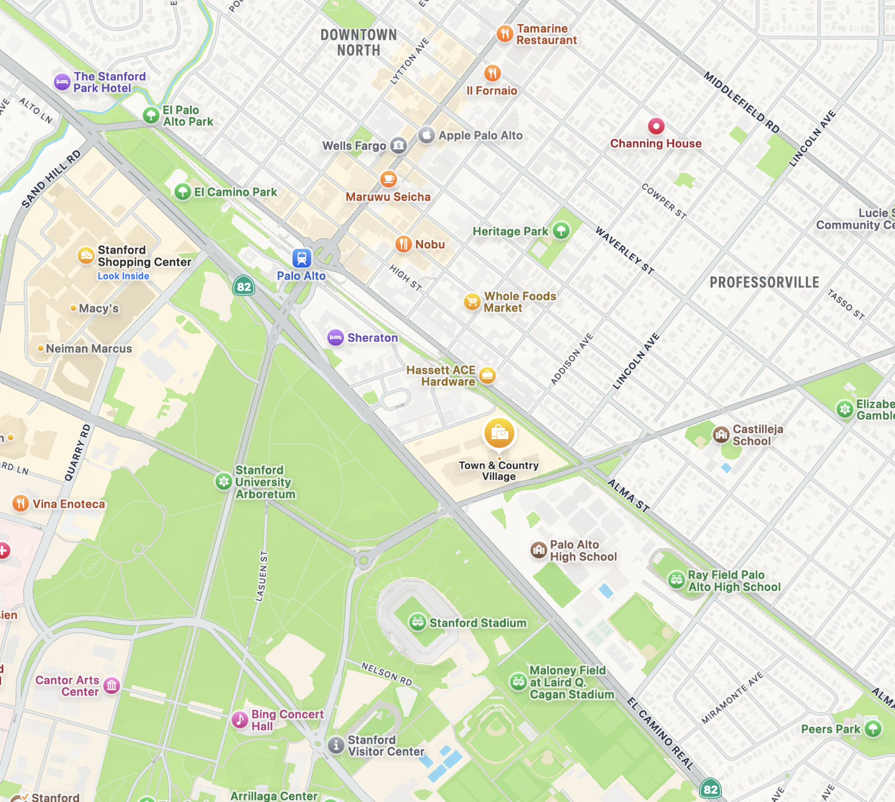
FINDING PARTICIPANTS
We went to Town & Country on two separate sessions (1 on Sunday and 1 on Wednesday. Appropriate location because:
Next to Palo Alto High School, Stanford, and Tech Giants Headquarter (Concentrated Ecosystem)
Community surrounded by tech resources, but still a variety of access gaps
Urban-Suburban Blend
Sought out any individual who appeared to be taking a break/had time to talk, not just for our sake, but for the sake of evaluating that break against their context of productivity. Productivity is not specific to one kind of person.
Notes:
T&C
Productivity is EVERYONE
Concentrated ecosystem

Slide 5
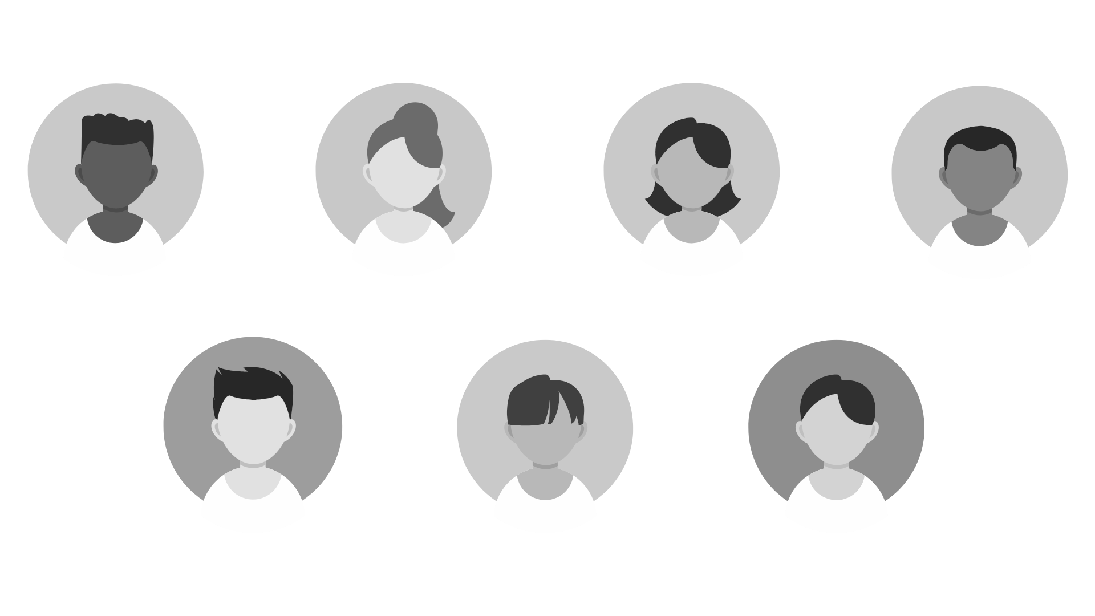
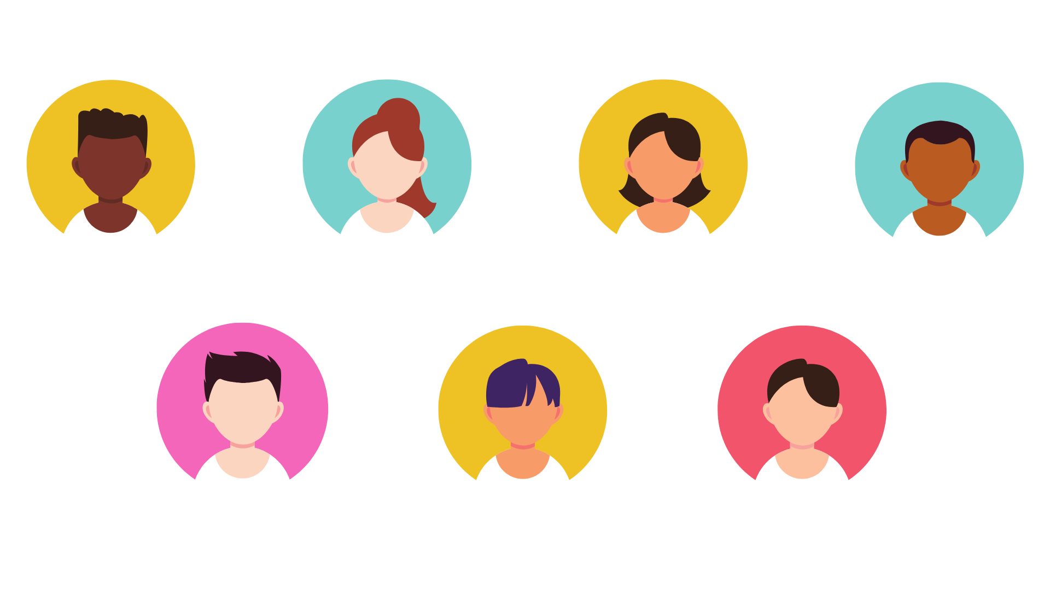
WHO WE SPOKE TO
JC, 17
Darcy, 59
Gabby, 20
Omar, mid-50s
Palo Alto HS Senior
Student-Athlete
Mother of Neurodivergent Children
Stanford Sophomore
Cancer Researcher
Barry, 19
Seth, 15
Jamie, 43
CSU Monterey Sophomore
Palo Alto HS Sophomore Student-Athlete
Retired Colombian Military, DoorDash

Slide 6
Primary Tasks:
High school homework & athletics
College schoolwork
Family & Home Care
Research
16 hour-a-day delivery work
Primary Languages:
English
Spanish
Education Levels:
Pre High school Diploma to doctoral graduate
Various Interview Methods
Video Recorded Interviews In English (2 w/ Gabriella as interviewer & Amesha as notetaker)
Video Recorded Interview in Spanish (1 Gil as interviewer and Bennie as notetaker)
Audio Recorded Interviews in English (1 Bennie as interviewer and Gil as notetaker)
Computer Written Interviews in English (2 w/ Gabriella as interviewer & Amesha as notetaker)
Handwritten Interviews in English (2 Bennie as interviewer and Gil as notetaker)
We looked for a variety of interviewees across race, age, profession, and gender.
Geographies of Origin:
Bay Area
Historical Palestine
Colombia
Michigan
Ecuador/Lebanon
Neurotypes (Not discussed in all interviews):
ADHD
Neurotypical
No compensation was offered, but we promised to be brief (25-30 min)
Variety of socioeconomic class deduced from primary tasks and location
Notes:
DIVERSE.
6 interviews in english, one in spanish
Range of everything
Mindful of power dynamics (intimidation)

Slide 7
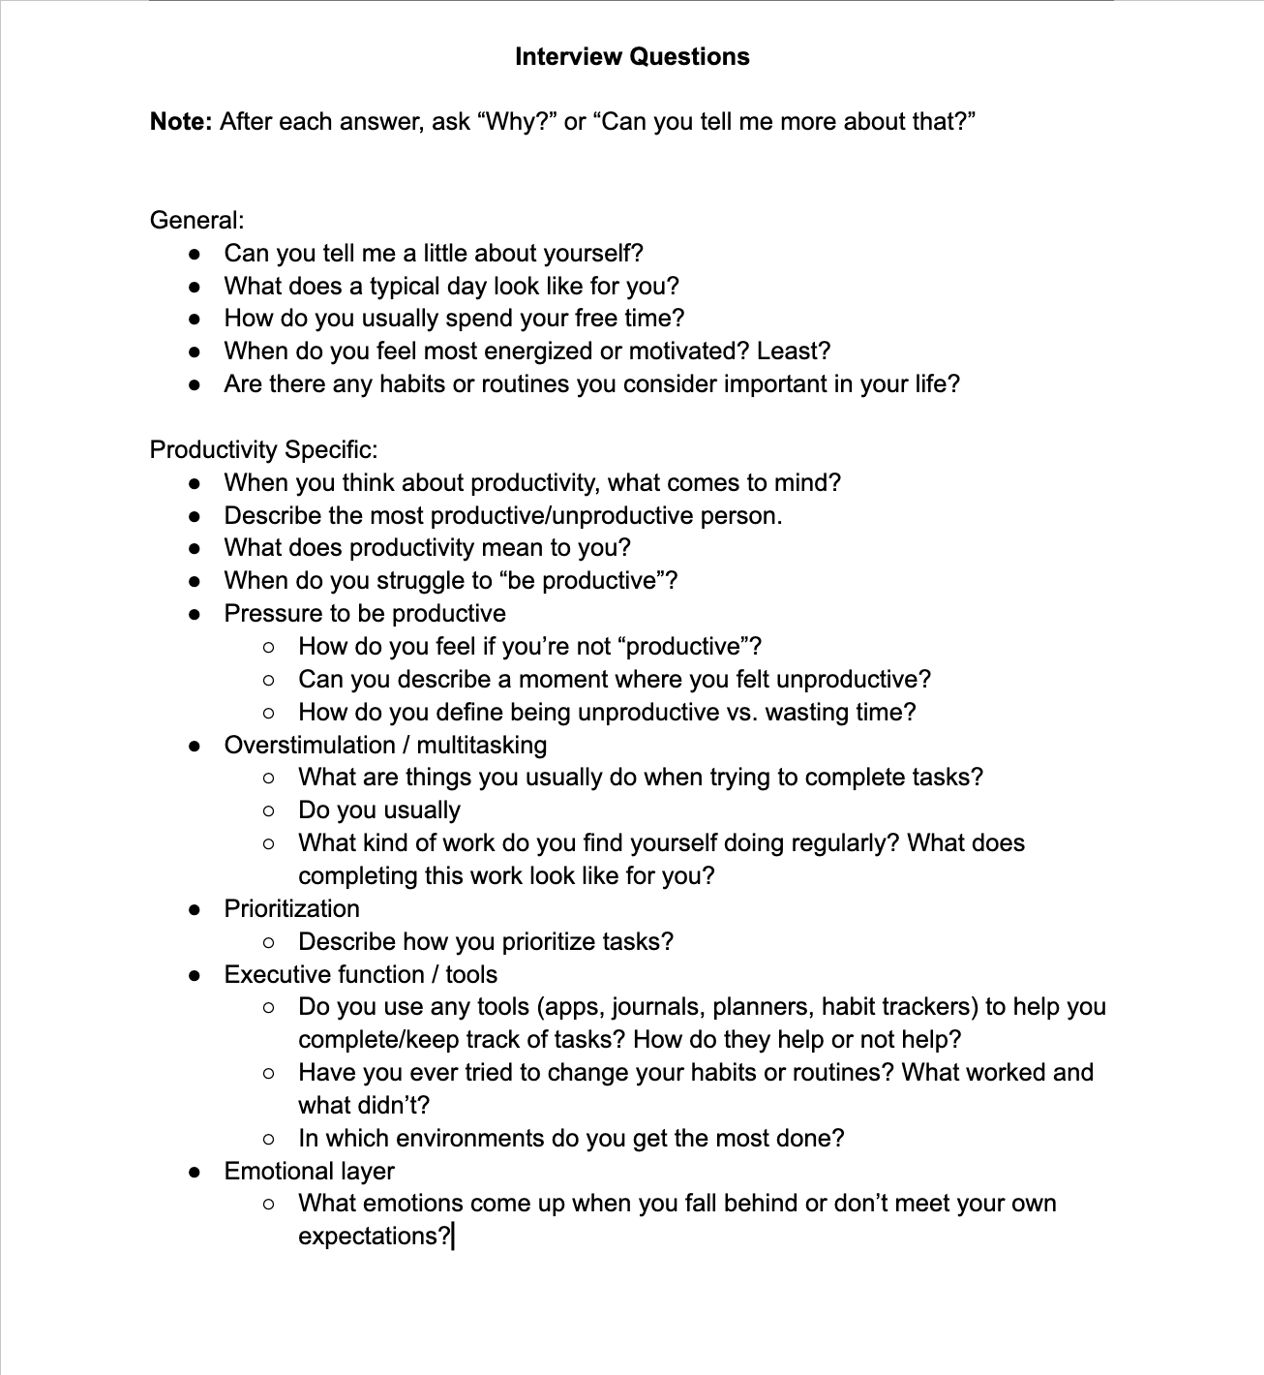
Walk me through your day
Describe the most productive/ unproductive person you know
WE ASKED THEM:
What tools or strategies do you use to stay on track?
Tell me about a time when you felt unproductive
What does “being productive” mean to you?
Notes:
Didnt specify productivity, had tehm do it
Holistic understanding of them as people, craft def
Their def vs their life

Slide 8
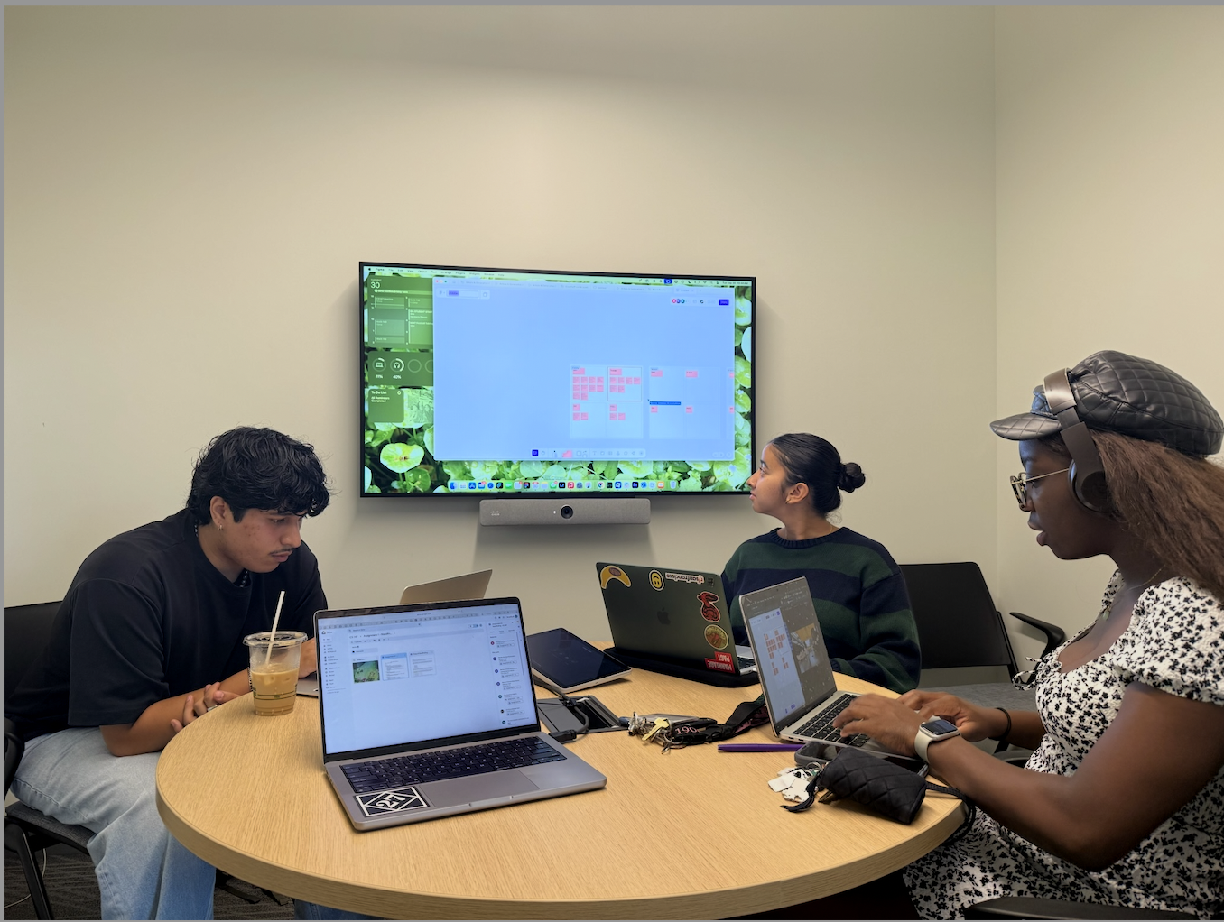
INTERVIEW RESULTS
Synthesizing the data
Creating findings from observations
Analyzing findings to create insights
Using insights to create needs
Notes:
All dis

Slide 9
IDENTIFYING EXTREMES
Scale: How reliant users are on organizational tools/systems for productivity
JC
Barry
Darcy
Jamie
Omar
Gabby
Seth
HIGH: Extreme reliance on tools routine, and other forms of predetermined structure
AVERAGE: Utilizes tools/systems, but tends to rely on intuition/feel
LOW: relies on habit/discipline over structure
Notes:
Based on reliance, aligned with perception of productivity
Showed difference between structure + discipline

Slide 10
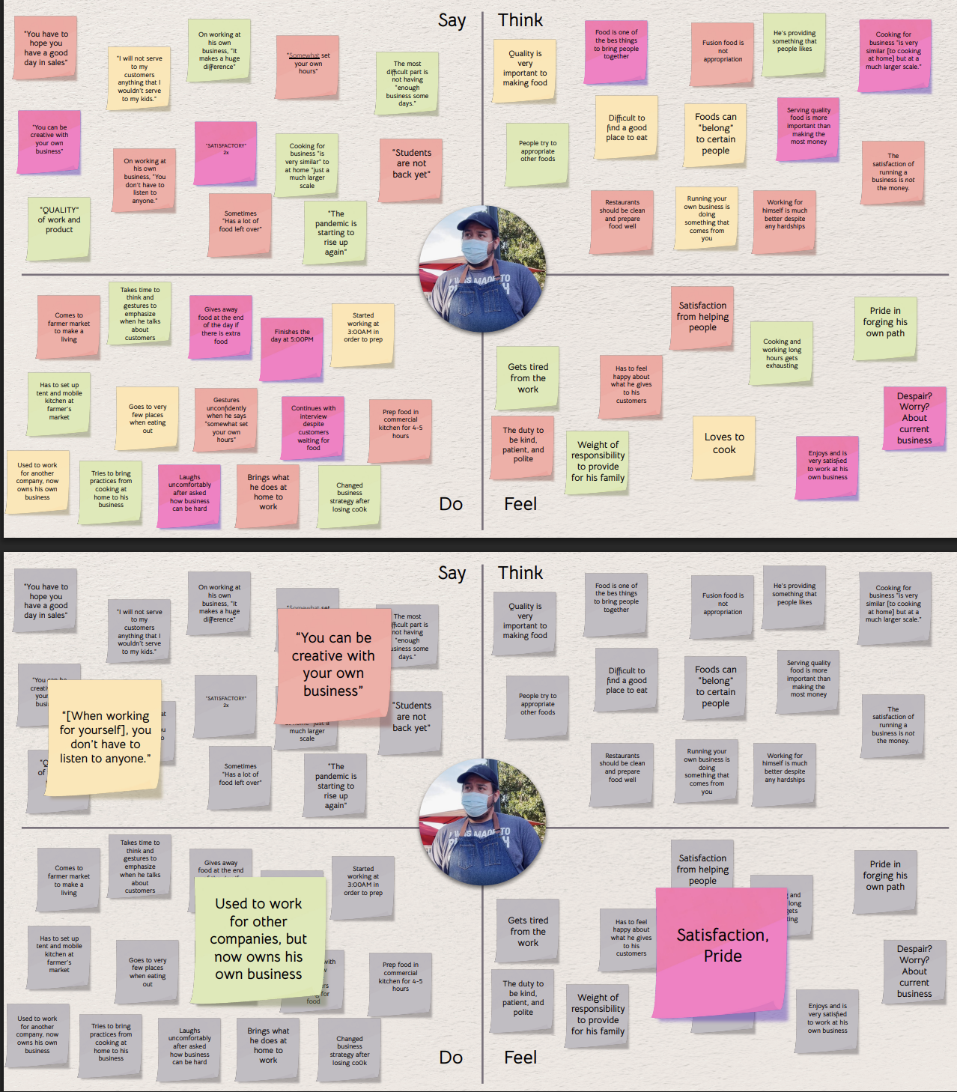
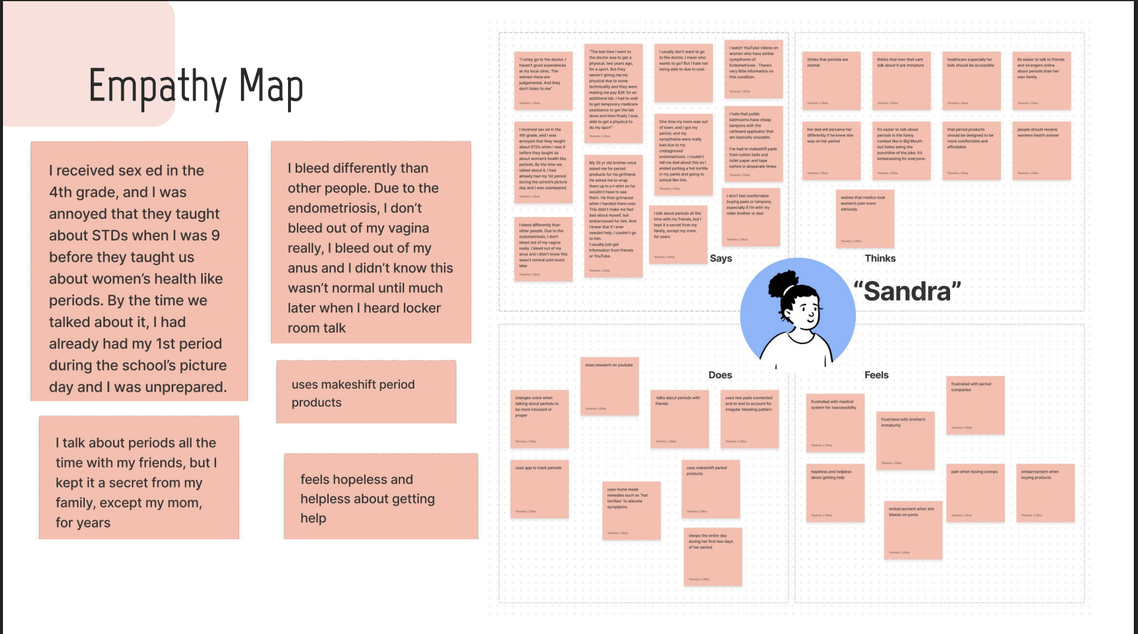
EMPATHY MAP (template slide)
Map + standout notes

Slide 11
“You are not always going to be working, so things like playing video games is not unproductive because that’s something that brings you joy.”
JC
17, Senior @ Palo Alto HS, Student Athlete

Slide 12
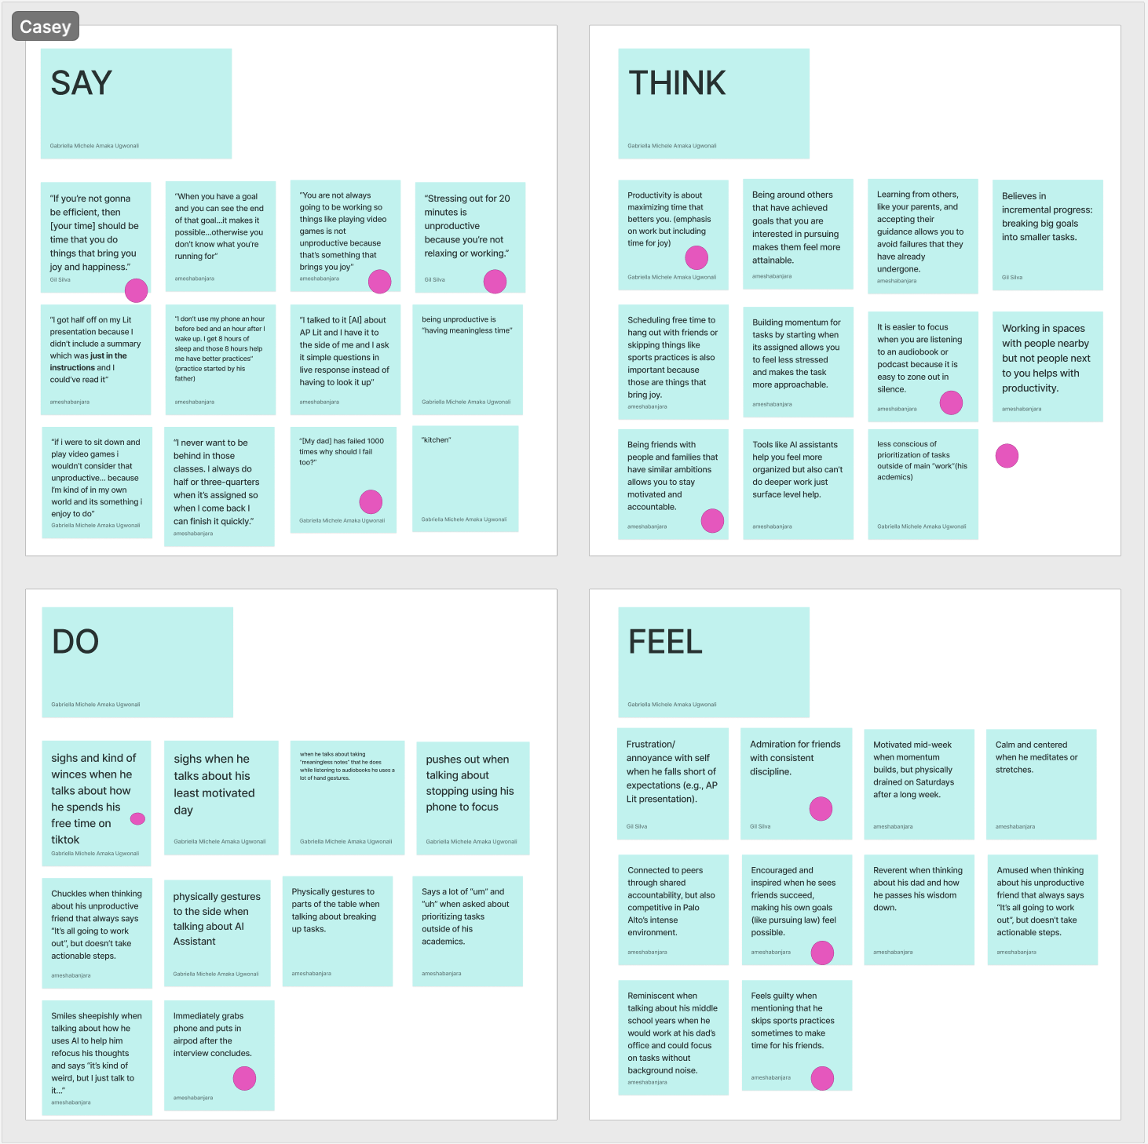
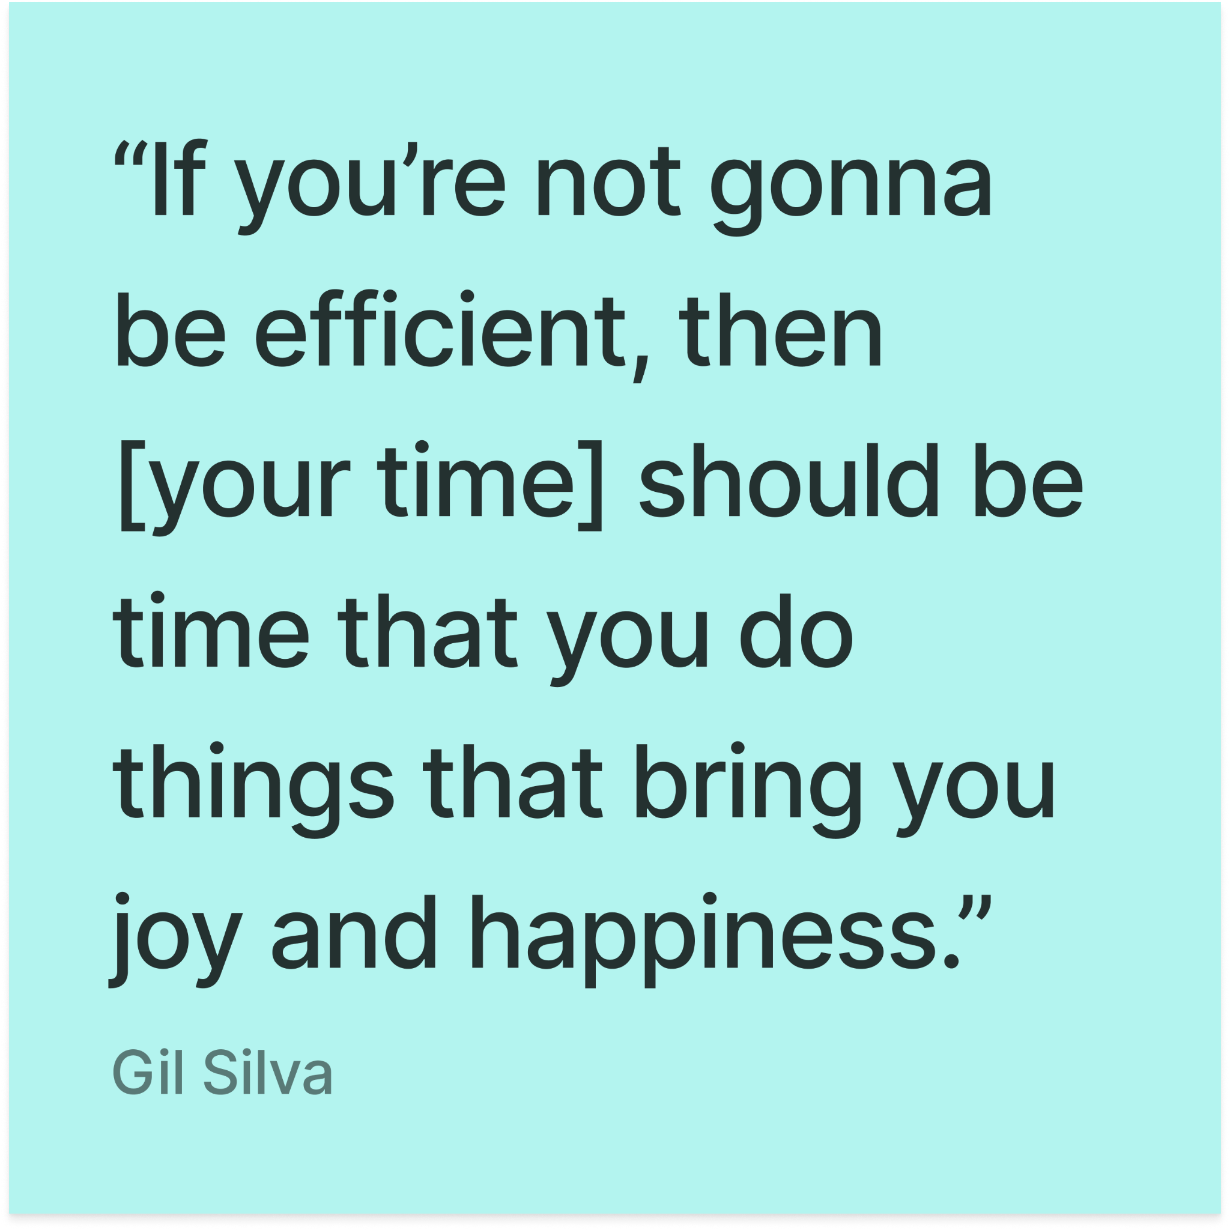
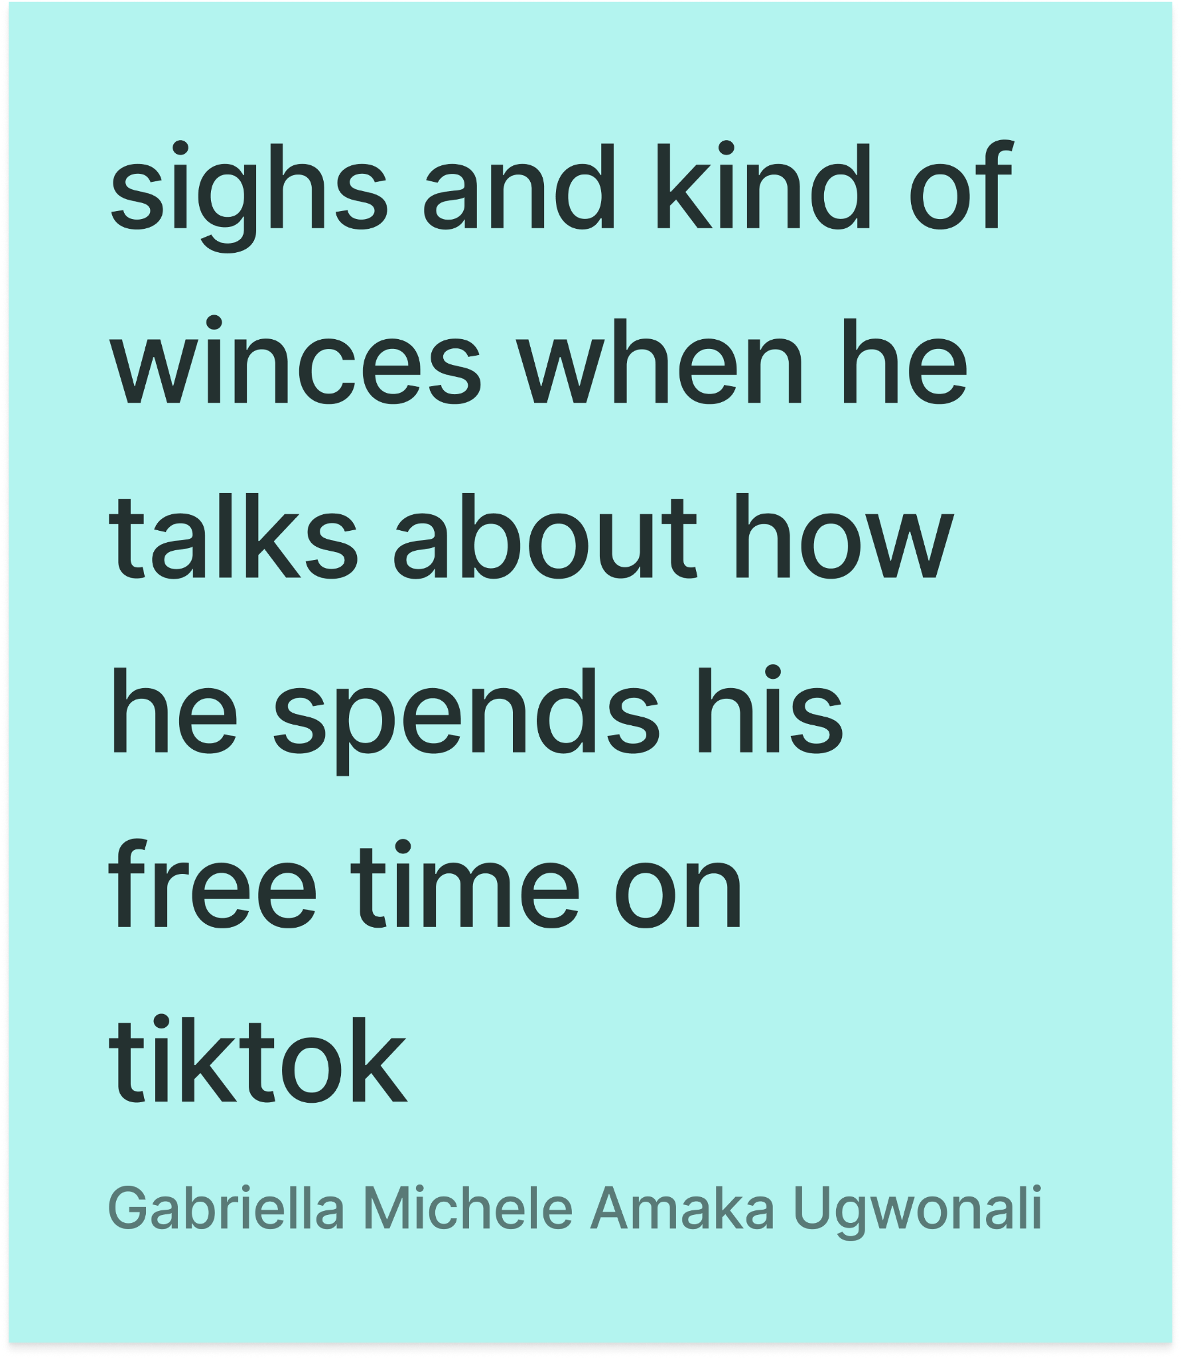
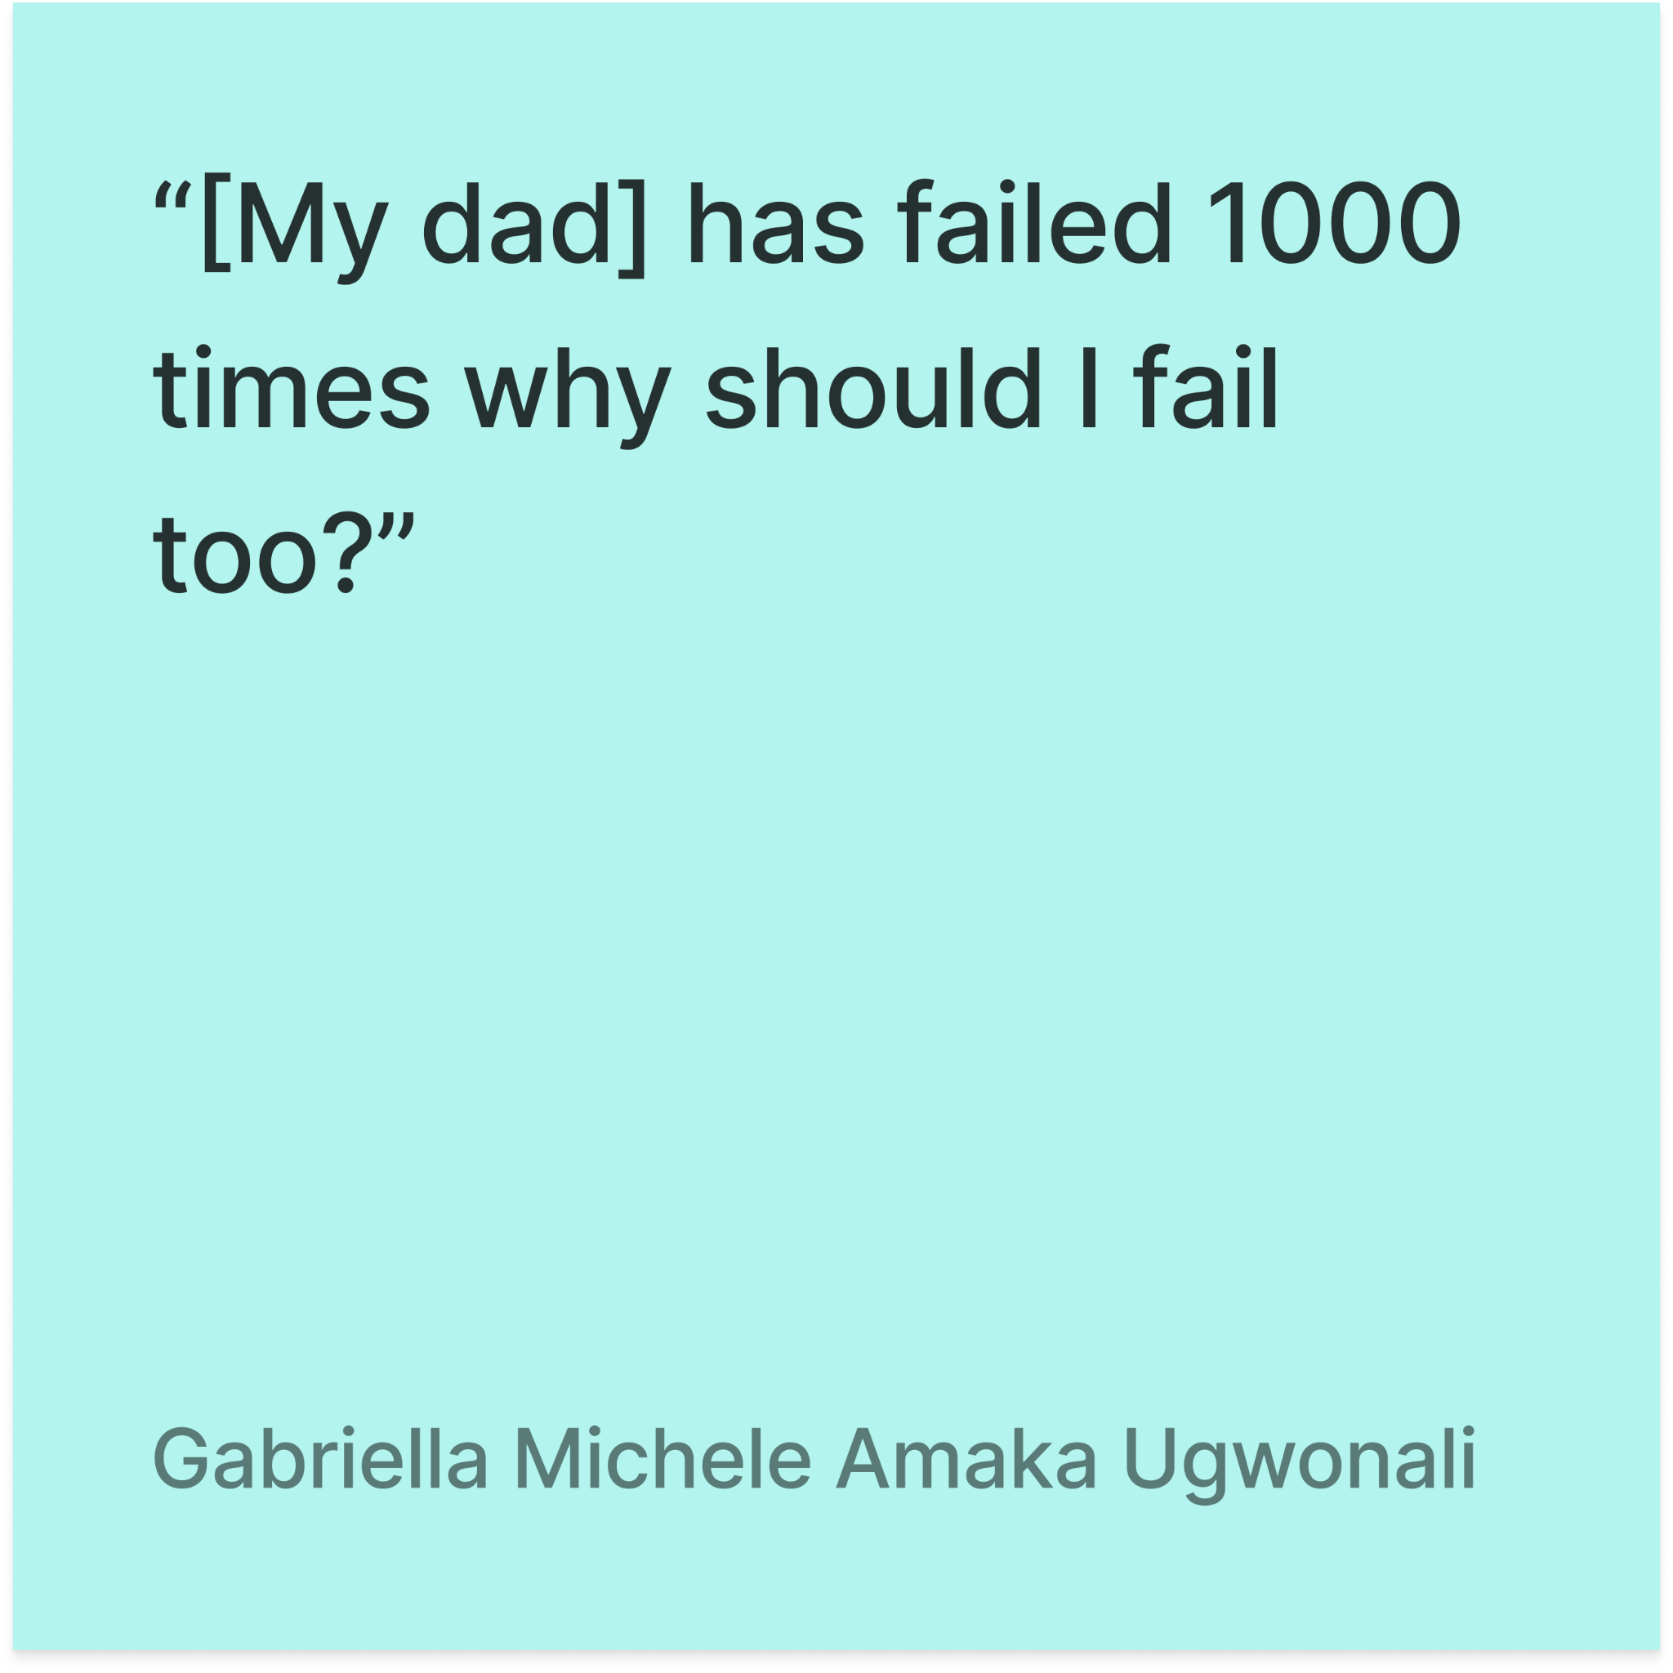
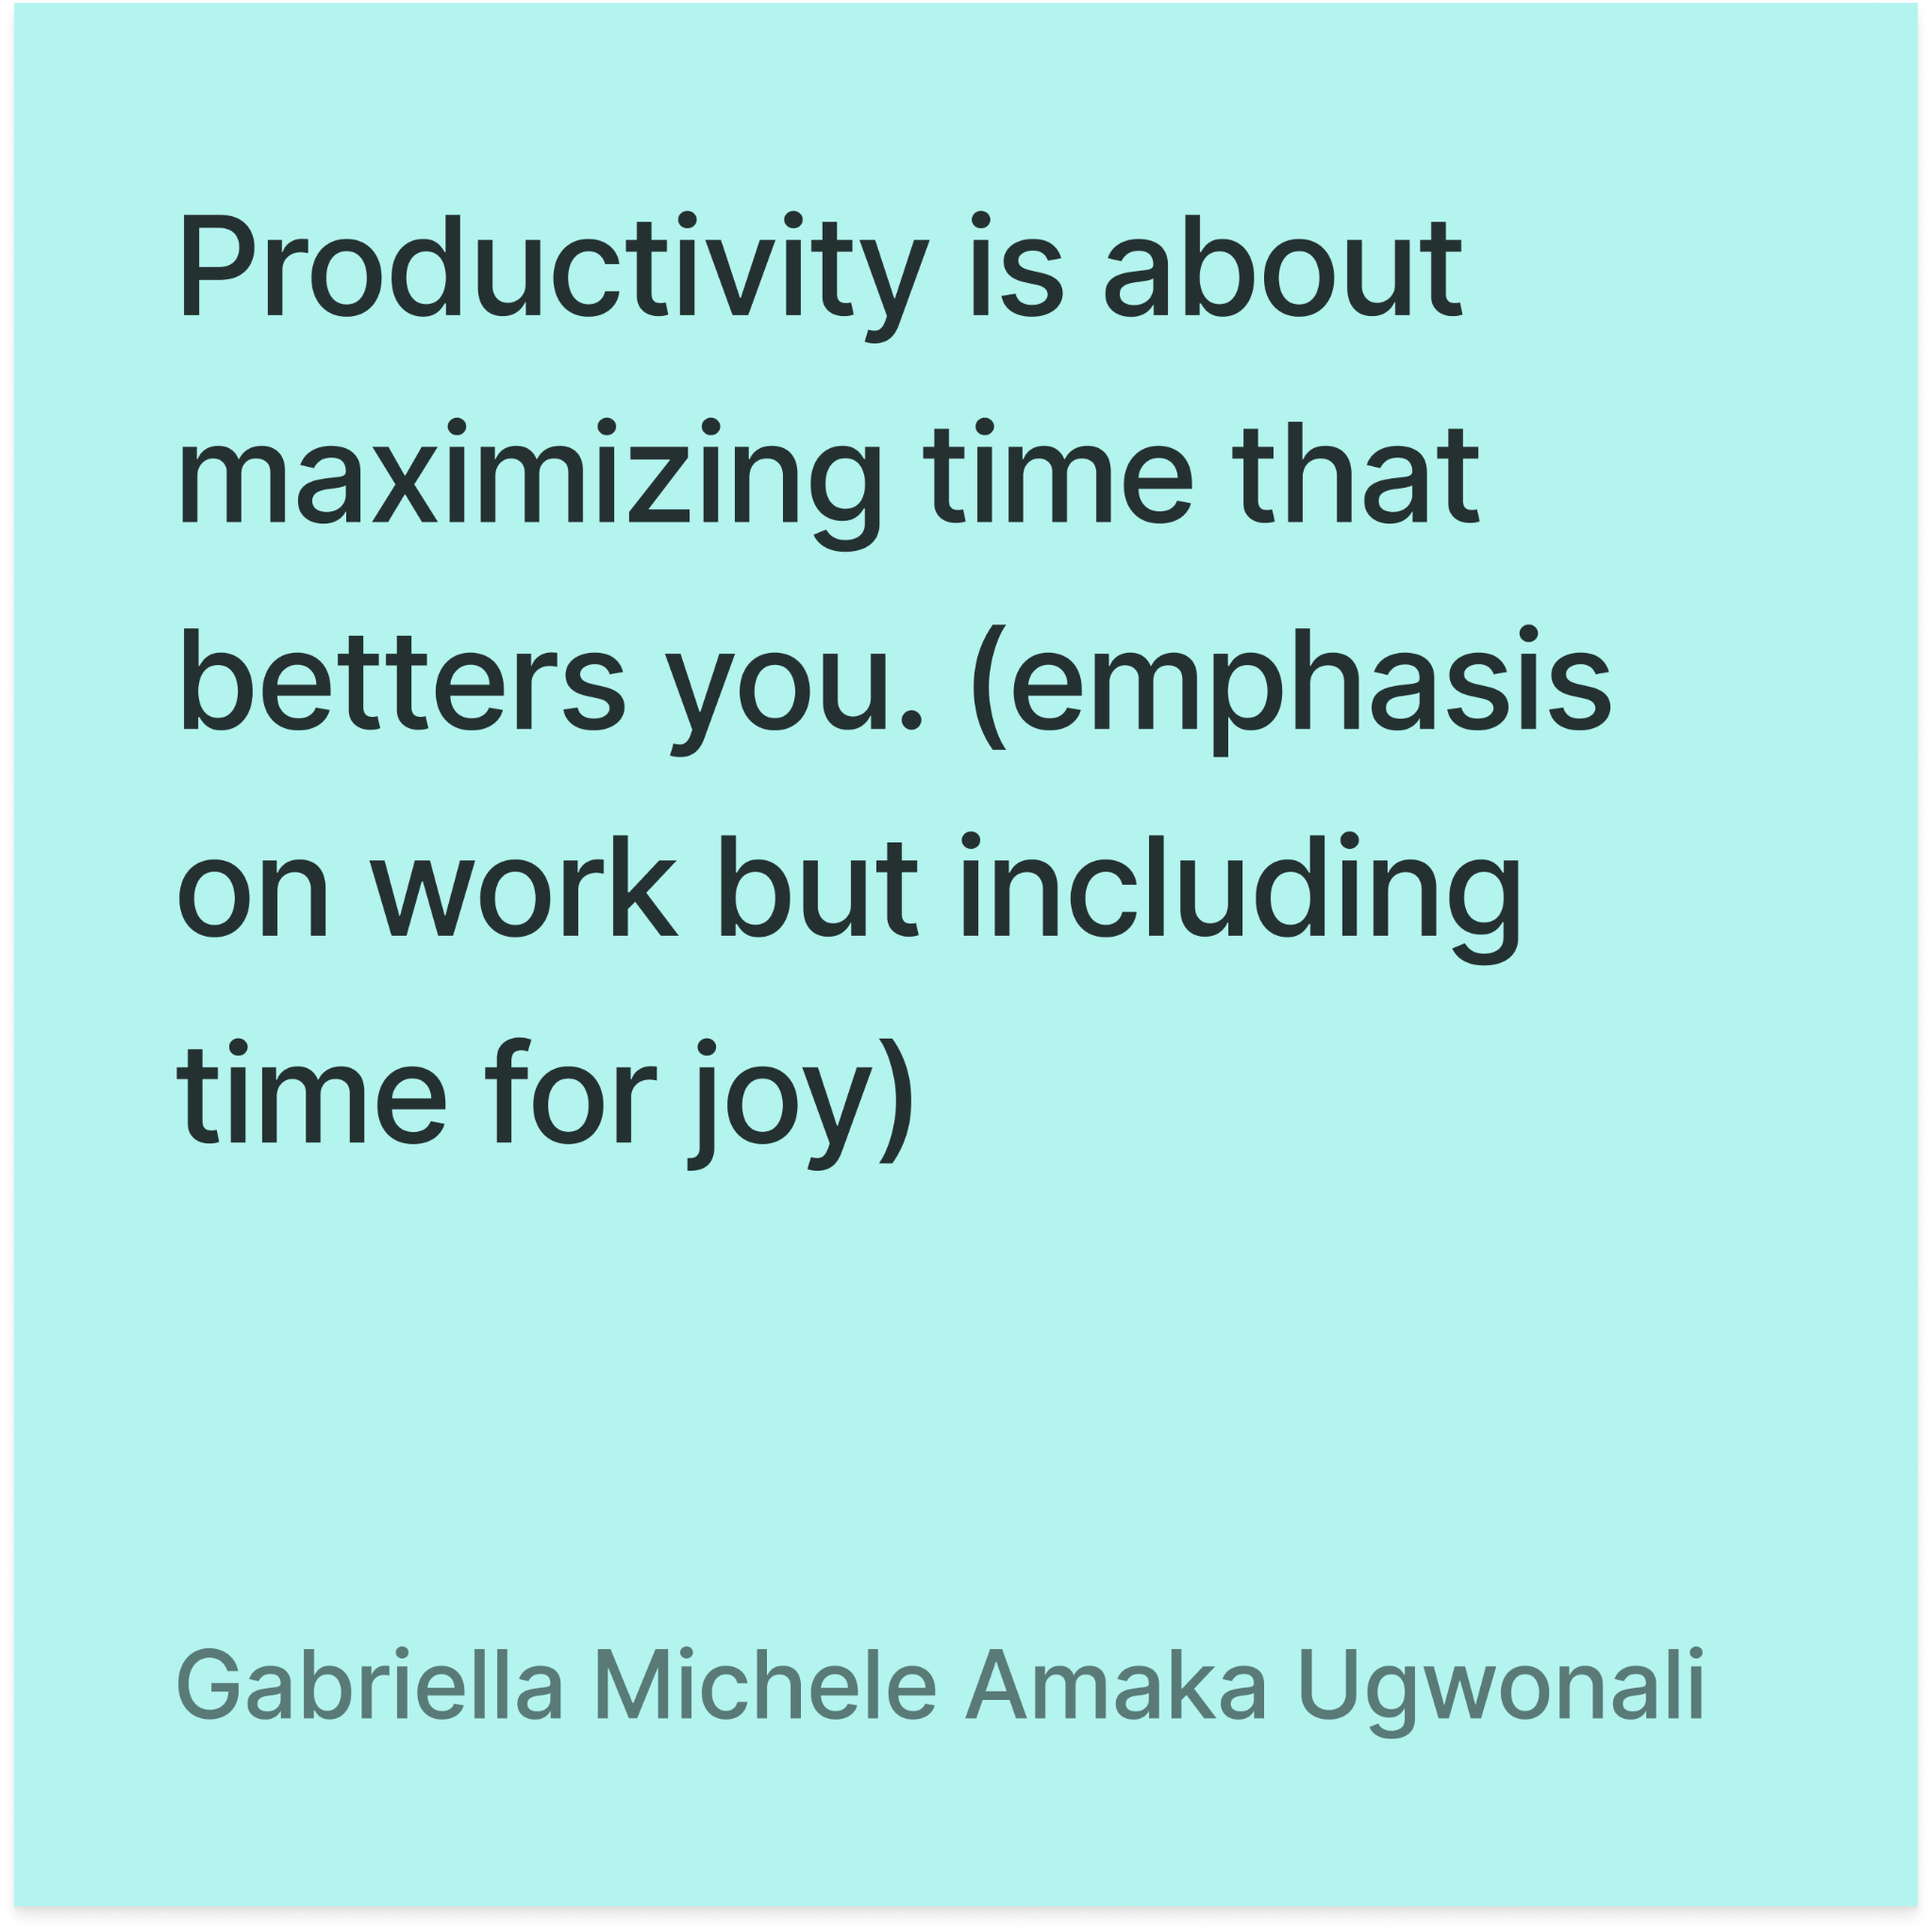
EMPATHY MAP
Notes:
Sitting there, immediately locked back in, able to step out quickly
Always doing SOMETHING, never a waste though
Inspired by lots of older people (dad, judge) so
More self-assured than most his age

Slide 13
“In American culture, [output] is a big deal, and I don’t like how it affects my boys. Love yourself for who you are without pressure of production.”
Darci
59, Mother of three neurodivergent sons, Burlingame, Michigan

Slide 14
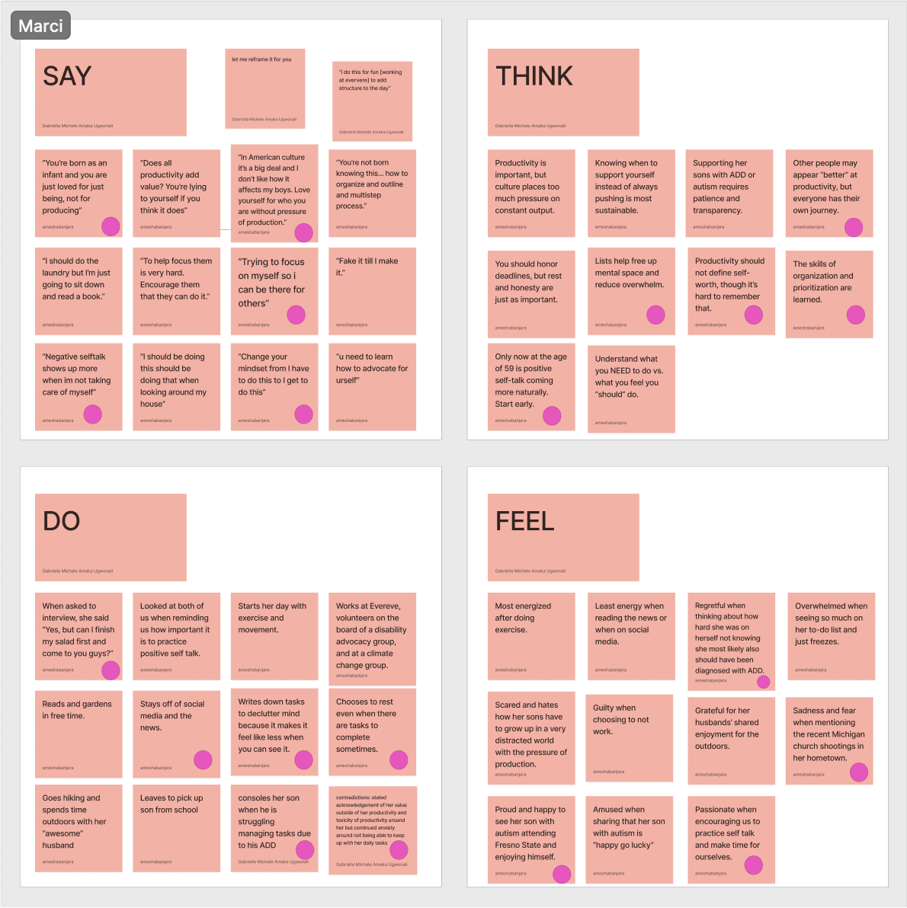
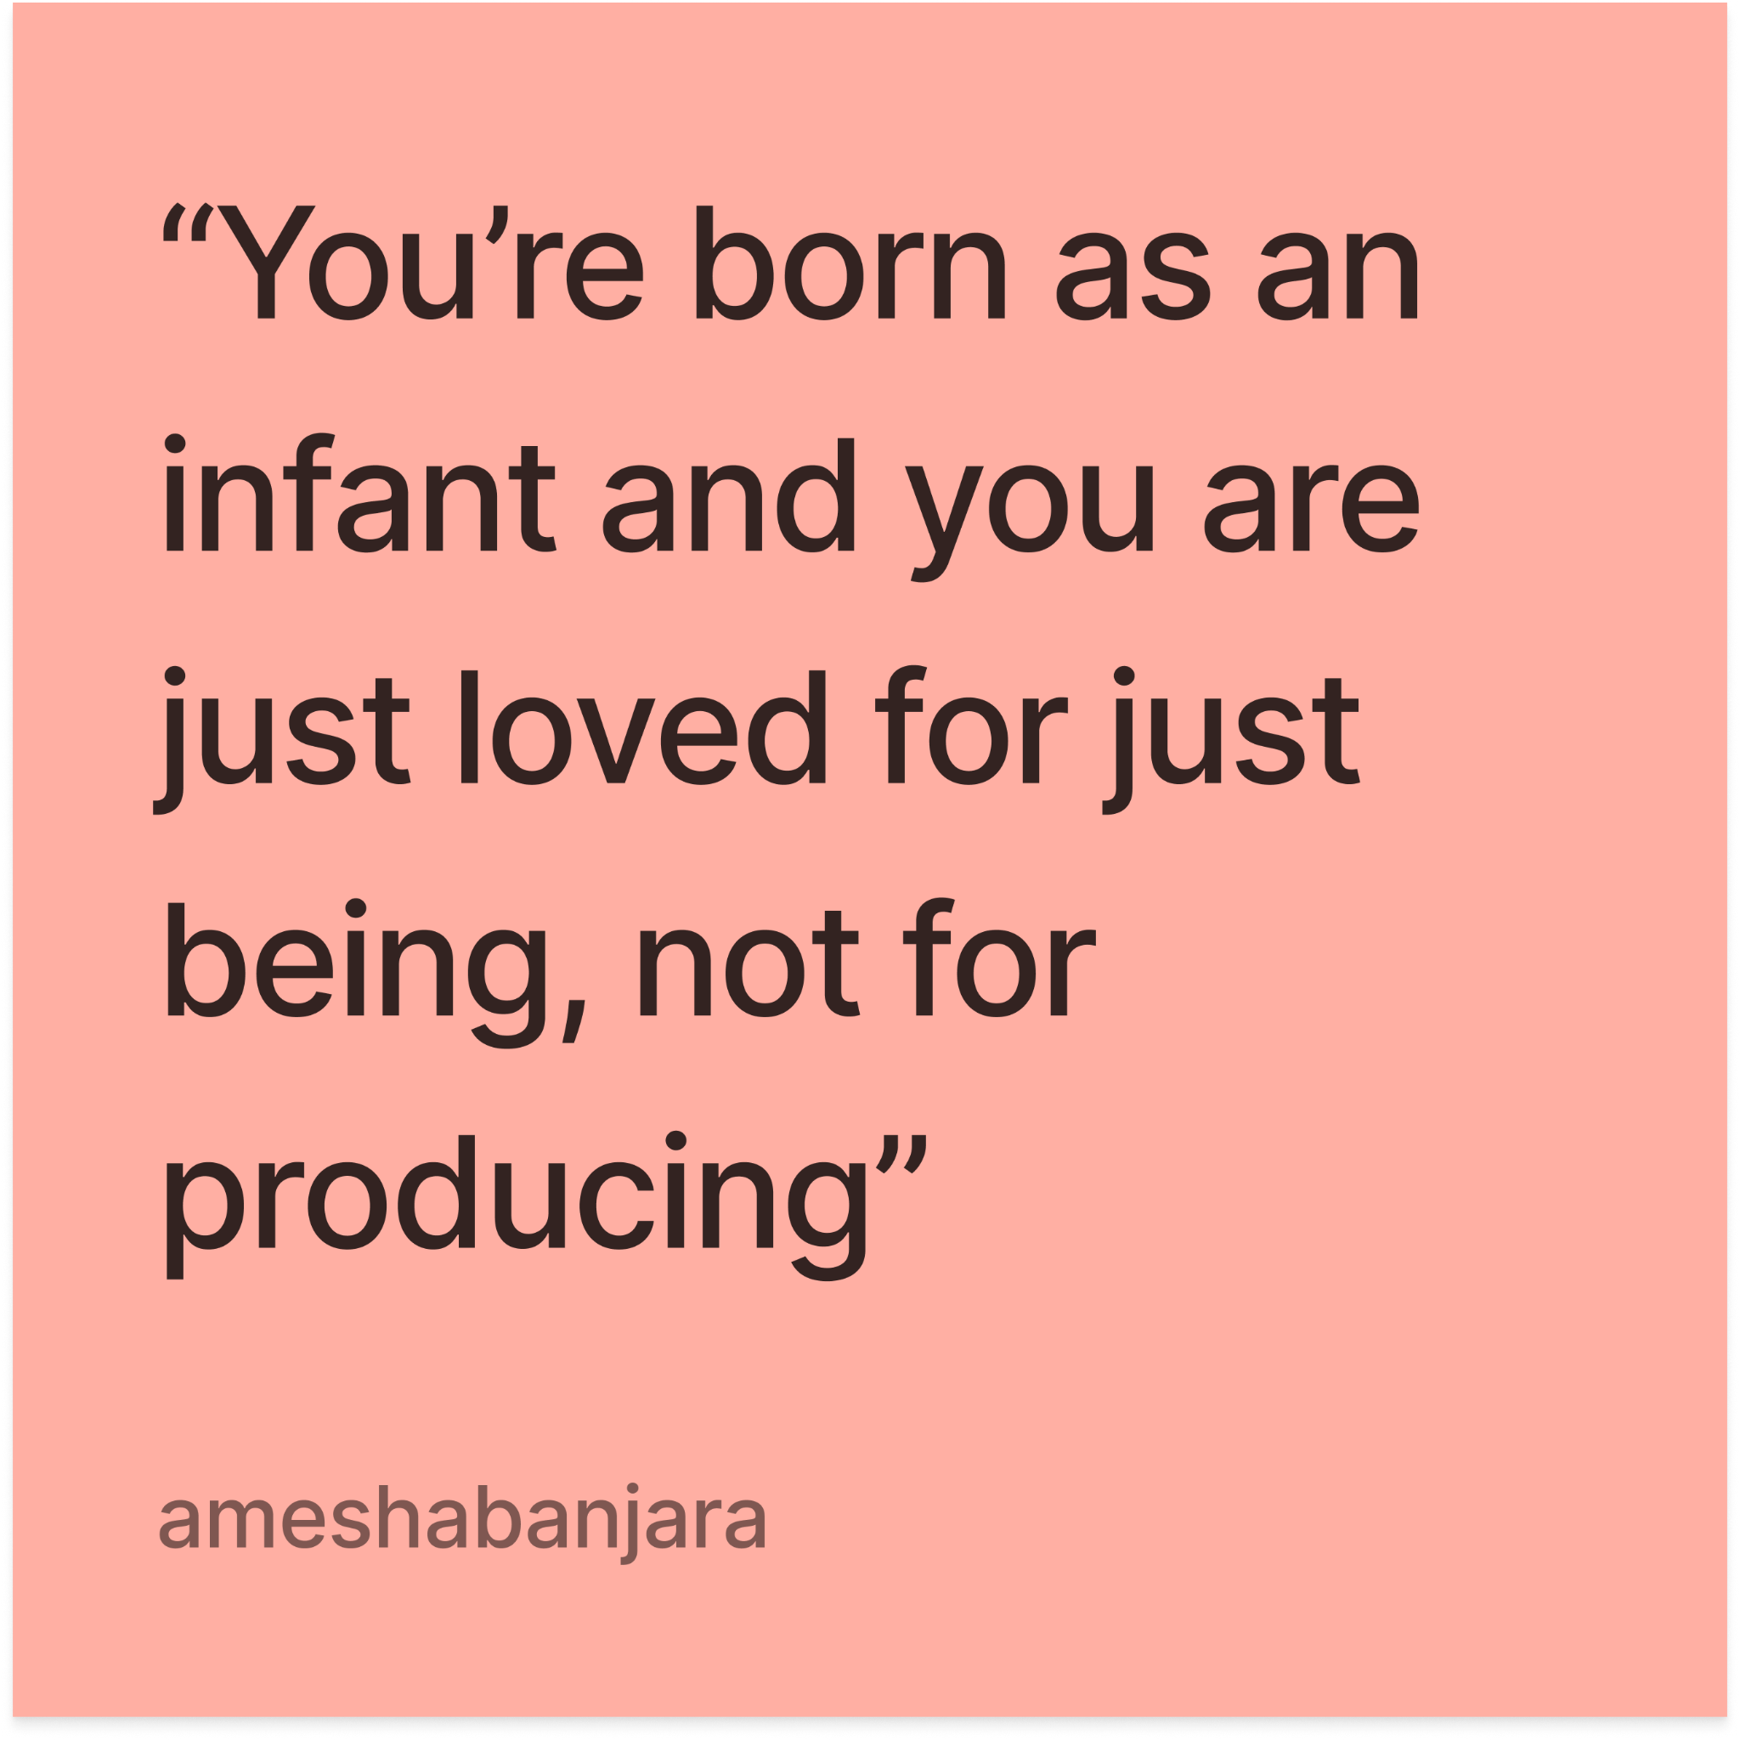
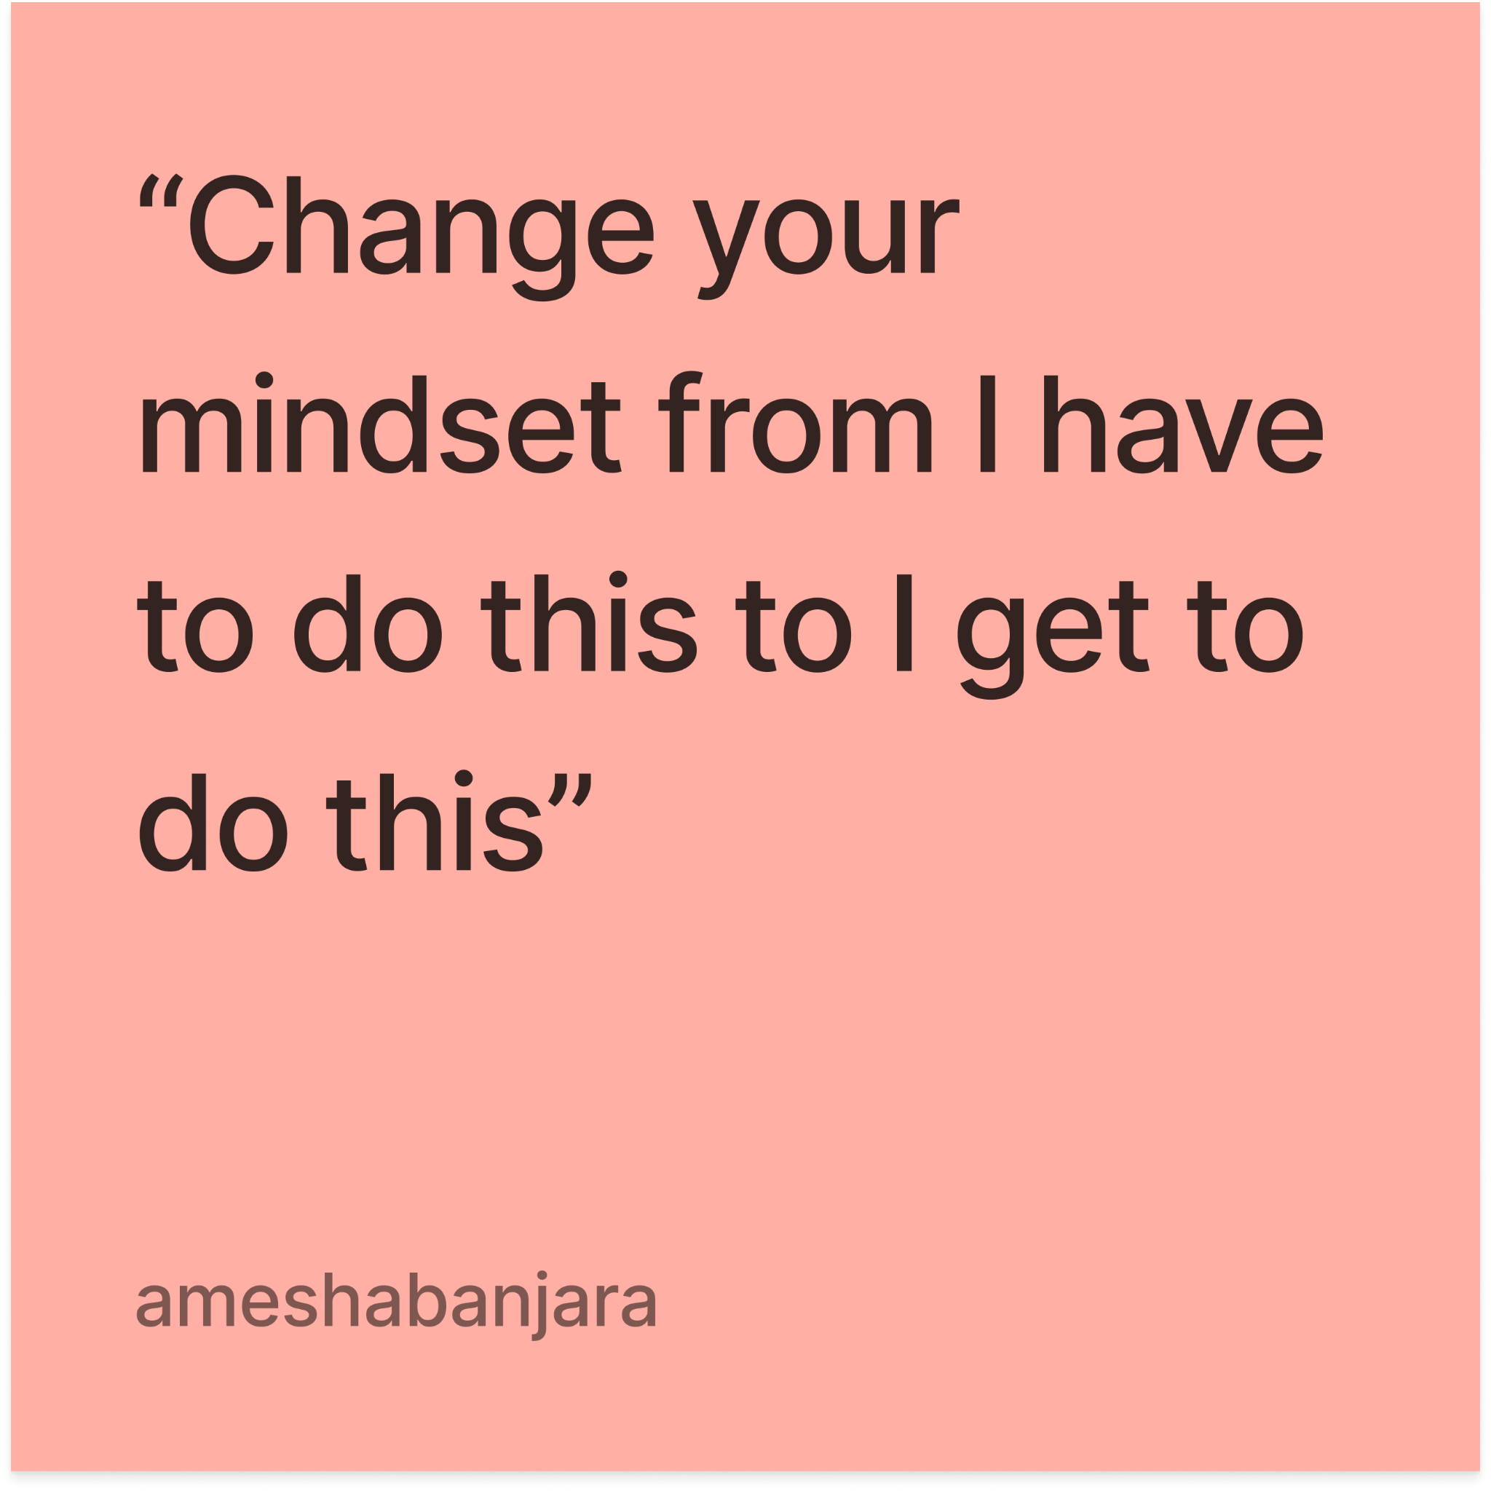
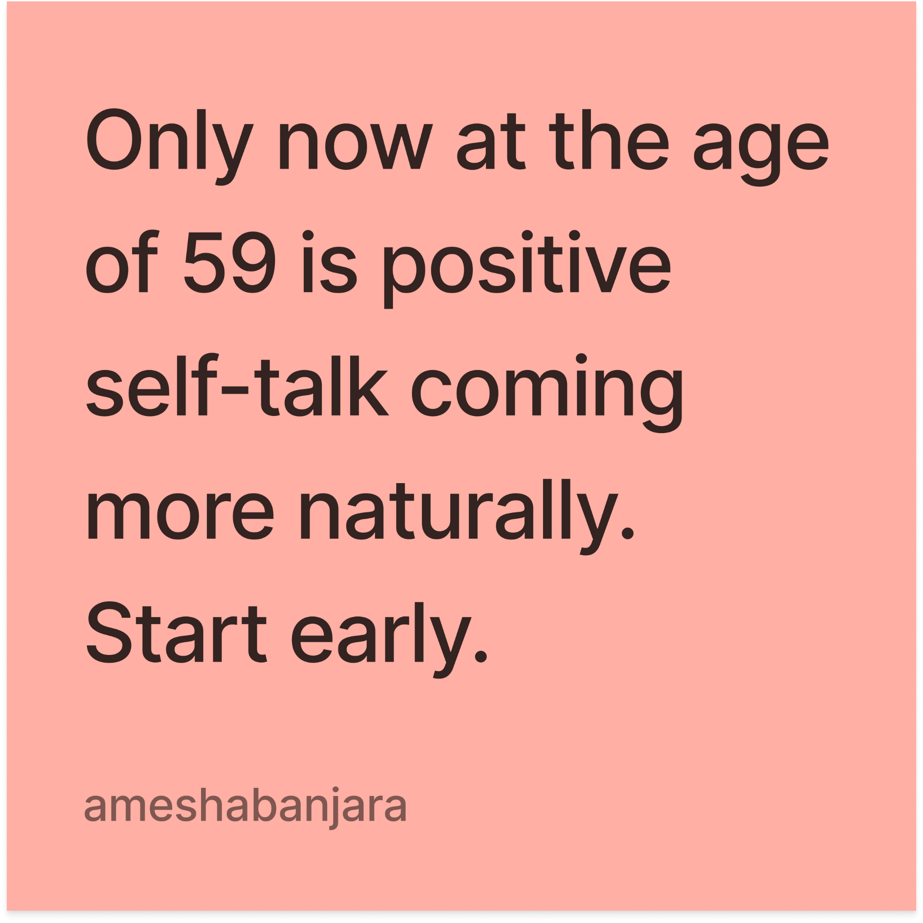
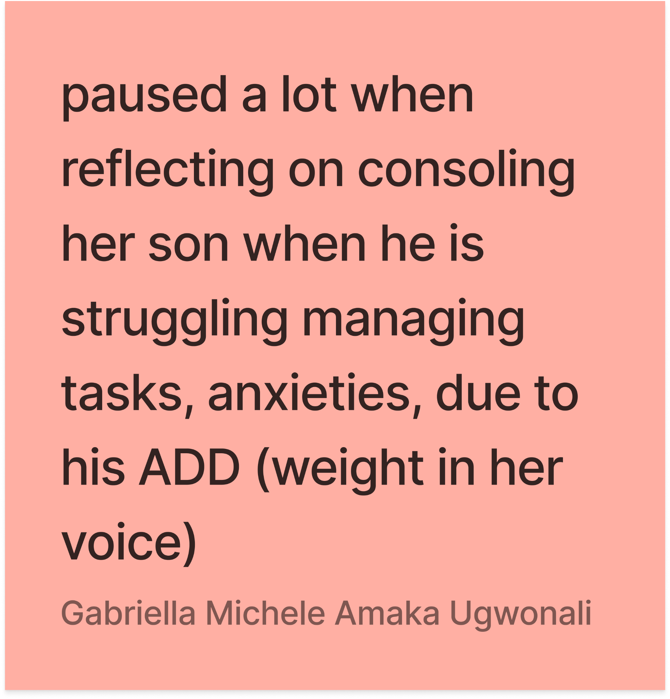
EMPATHY MAP
Notes:
General tone of care + acceptance as root of rejecting “prod”
Very much giving advice, almost take heed of warning vibe
Her prod was balance, deprioritizing work, effect on others
Rejecting pressure on output, prioritize happiness
Detach emotionality from stereotypical prod.
Many metaphors about life tied to motherhood
Theme of giving gravure

Slide 15
“In American culture, I find that everything is much faster. Everything is so fast-paced.”
Gabby
20, Stanford sophomore, Lebanon, Ecuador

Slide 16
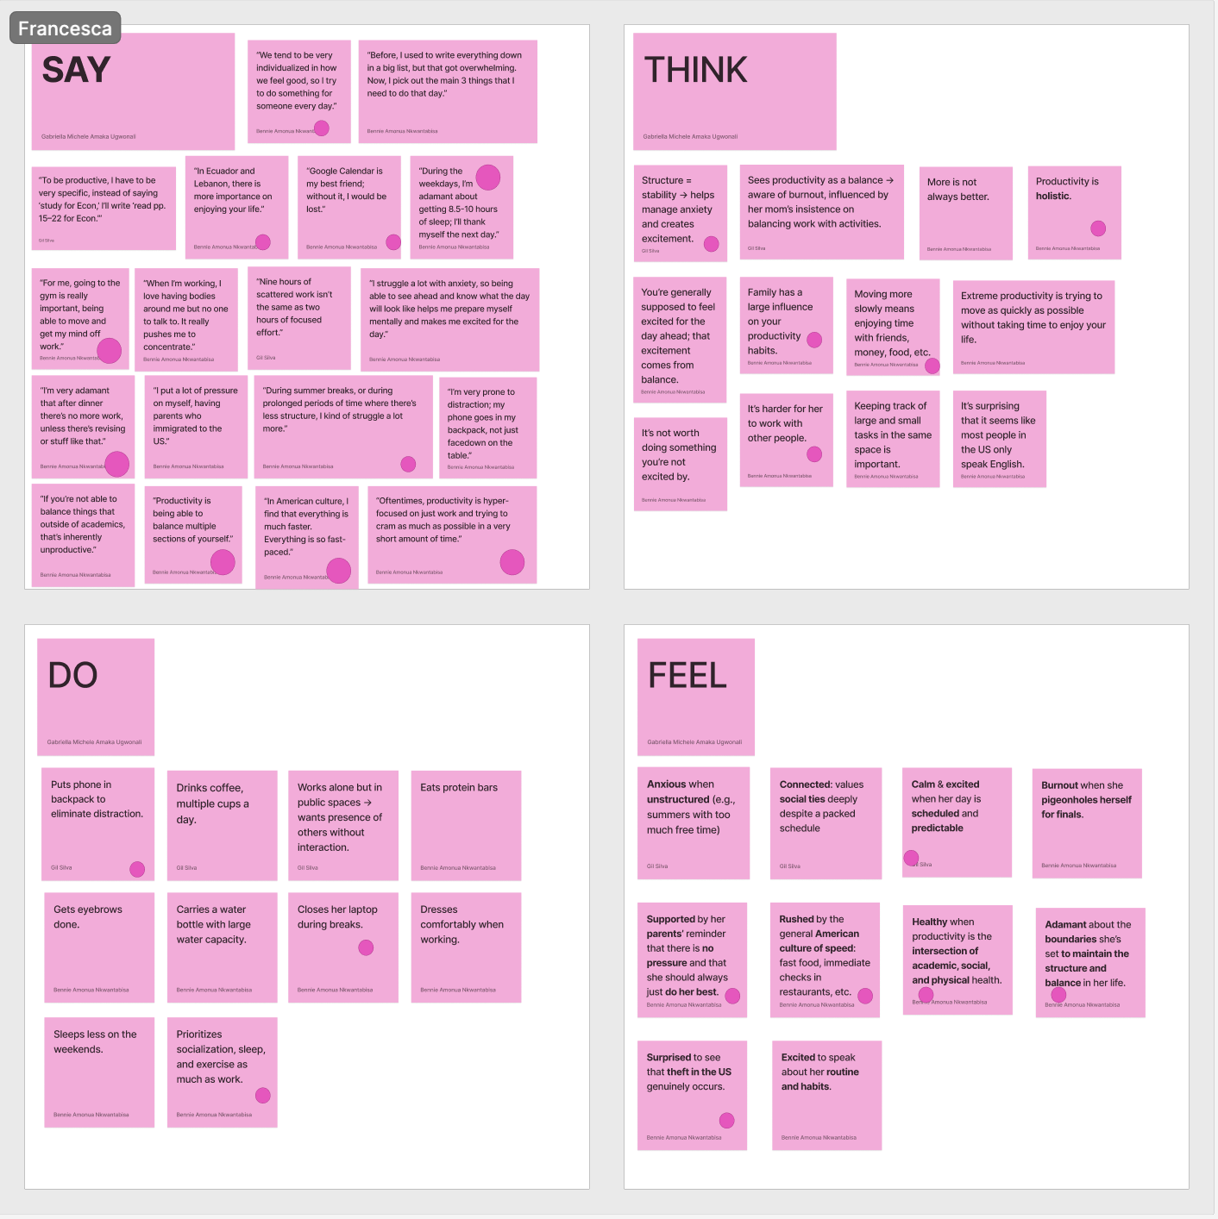
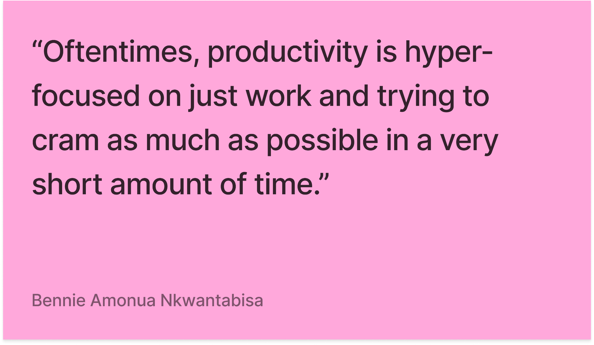
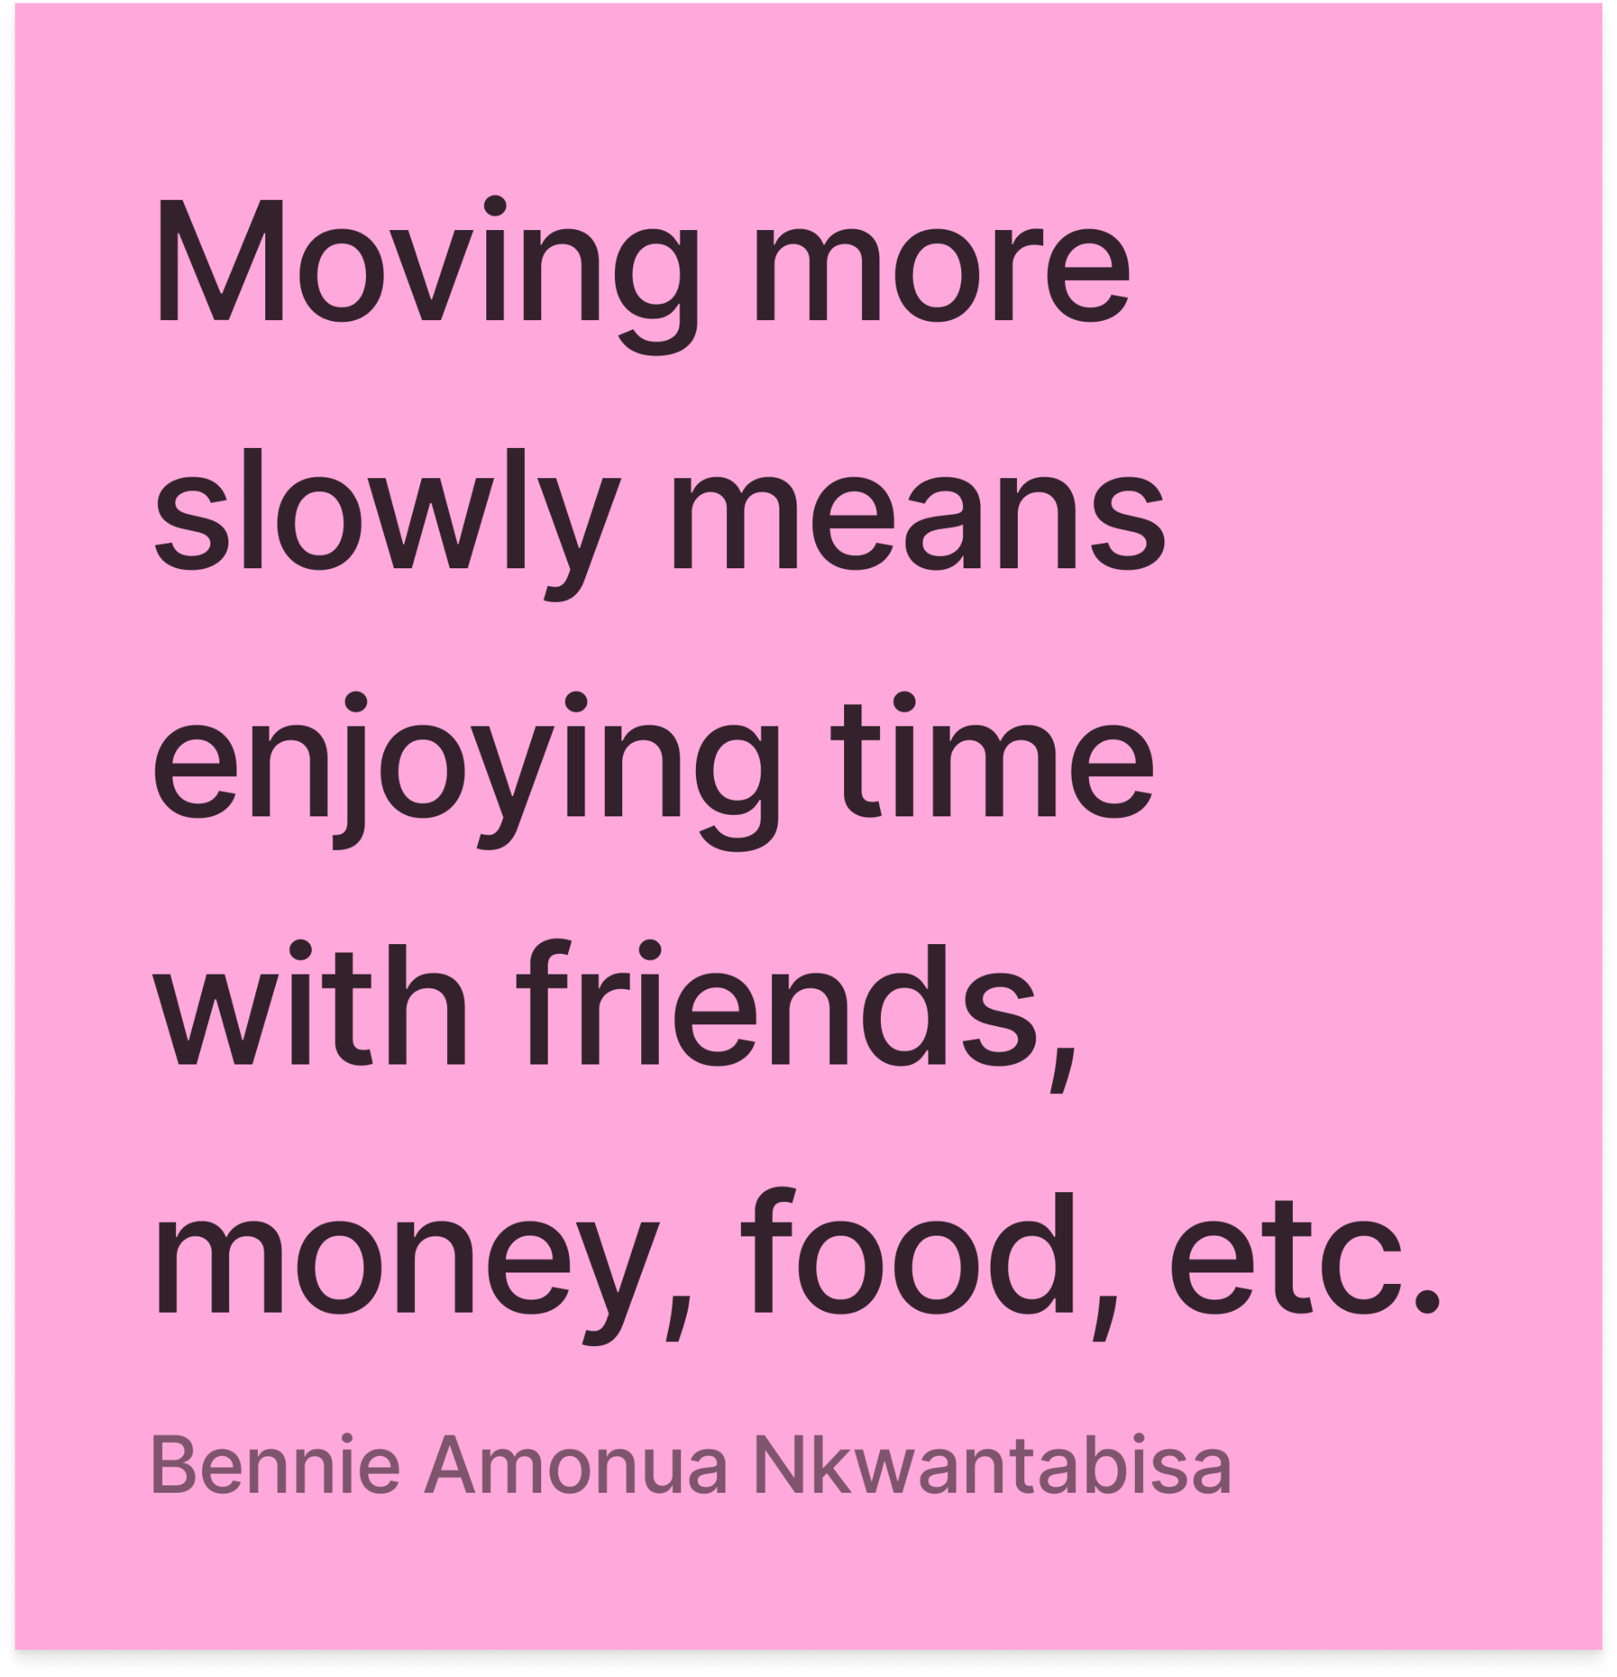
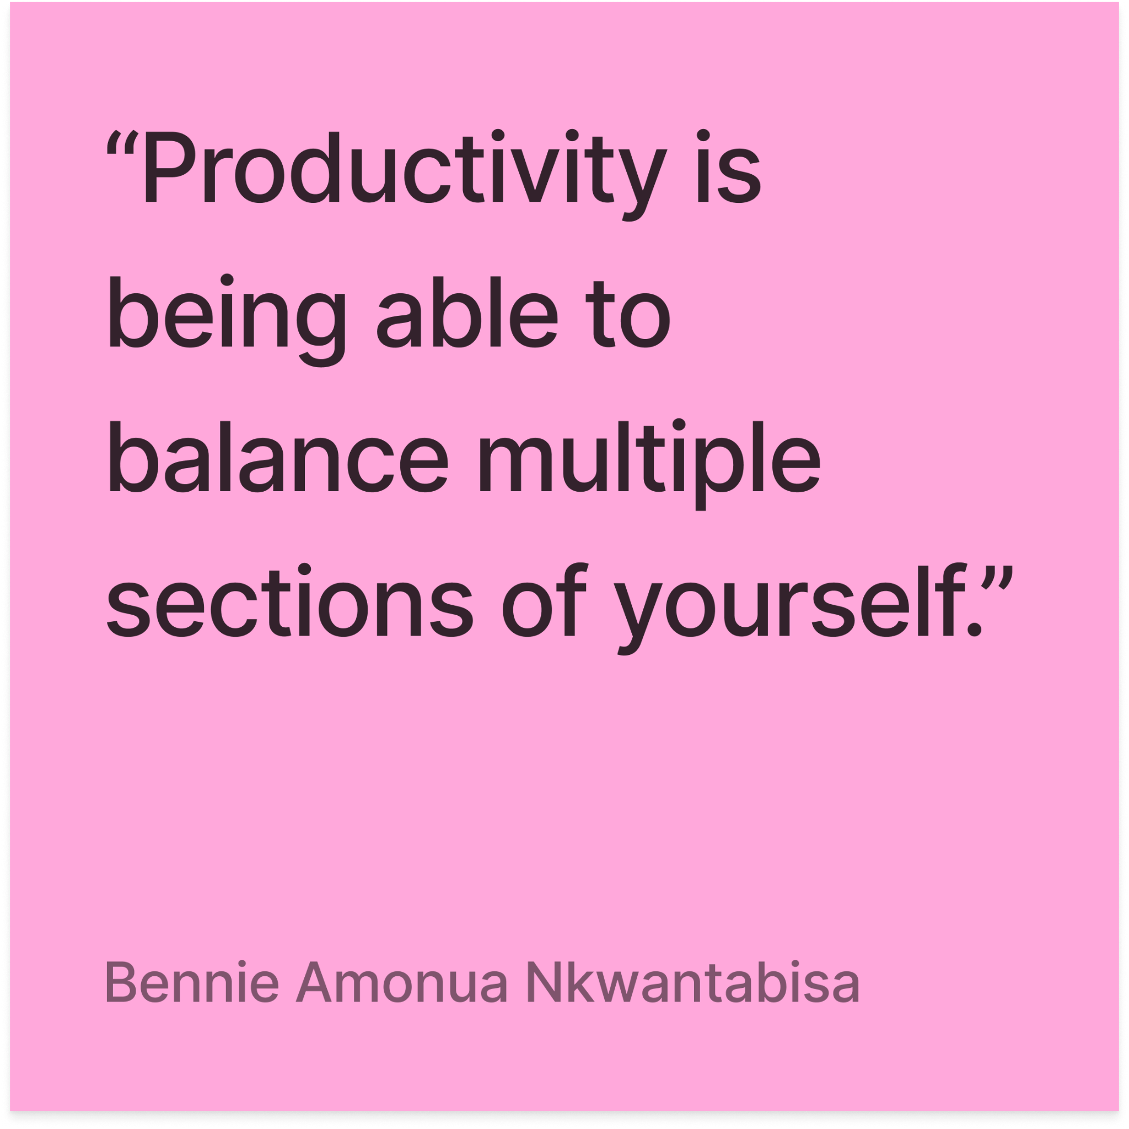
EMPATHY MAP
Notes:
Has it together by conv. Standards.
High-achieving, boundaries, structured, disciplined
Productivity is Intentional, Sectional
Enjoys Disambiguity/structure
Comparative lens, very contextually focused
Prod is holistic, social emotional mental phyical are just as important
Speed, americans move FAST (food, bill)
Moving more slowly

Slide 17
“Humans are inherently collectivist; individualism goes against our nature.”
Omar
Mid-50s, Drug Discovery Scientist, Manager, Historic Palestine

Slide 18
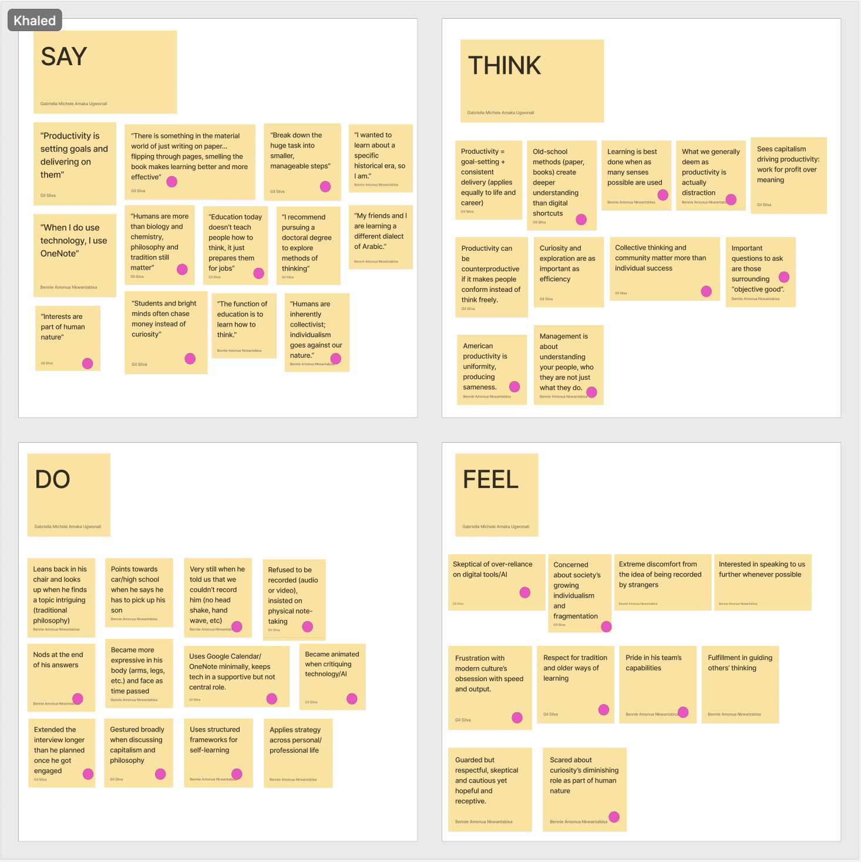
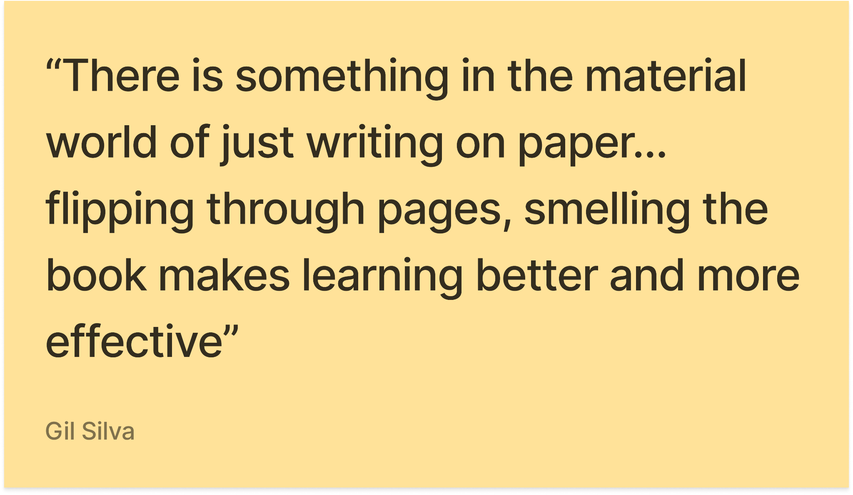
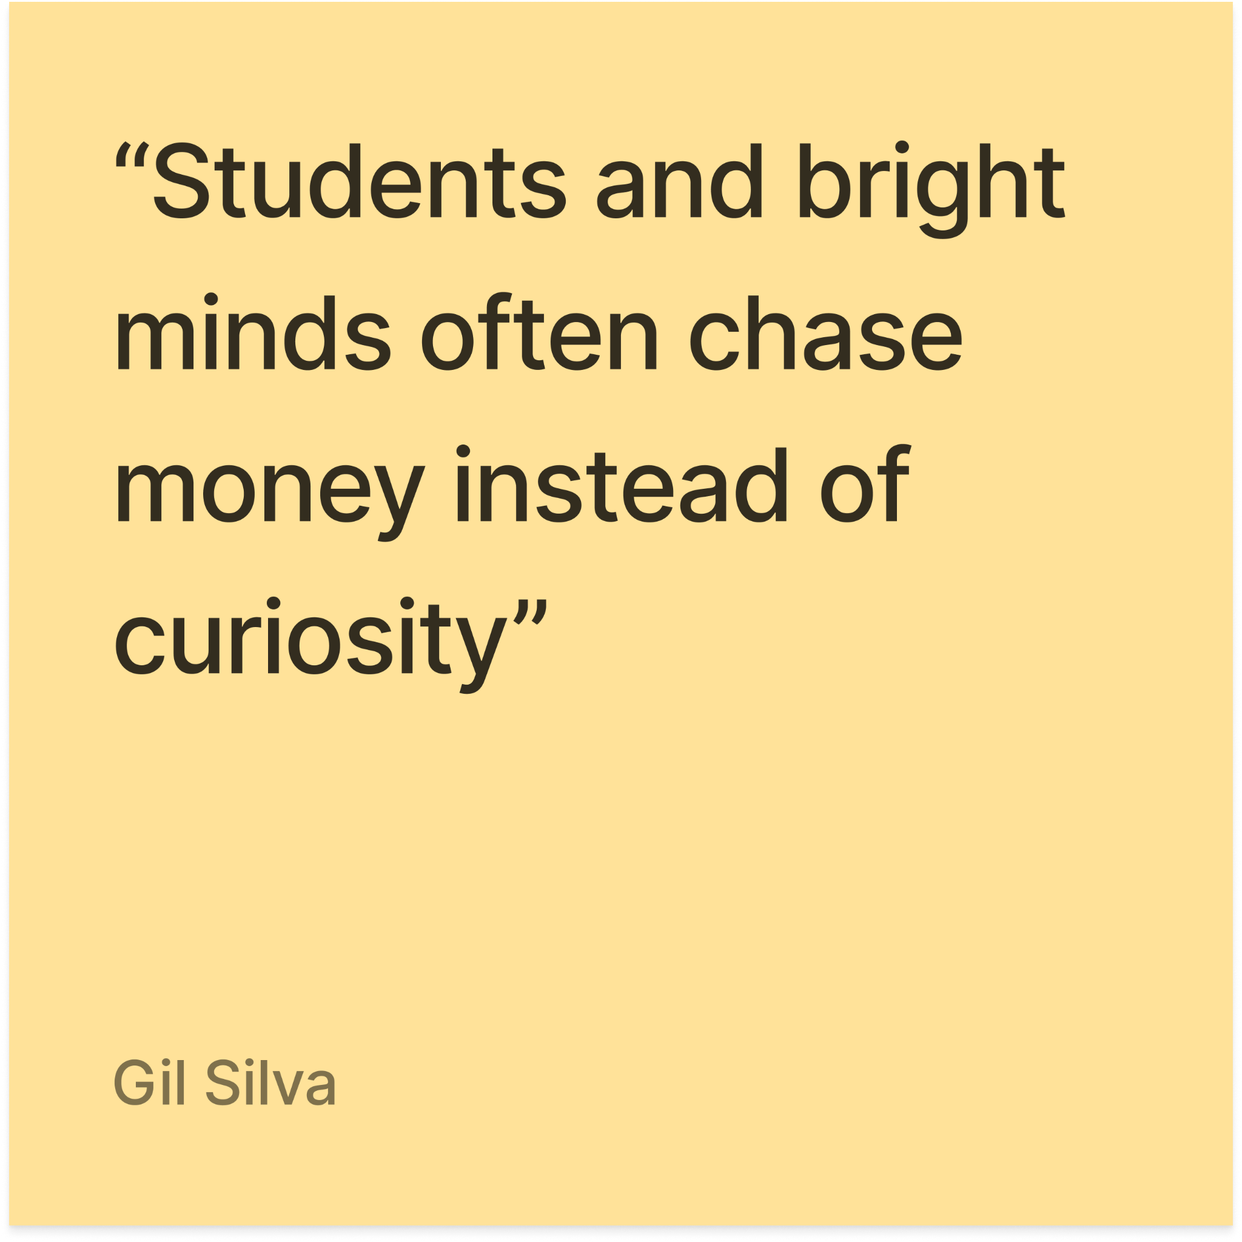
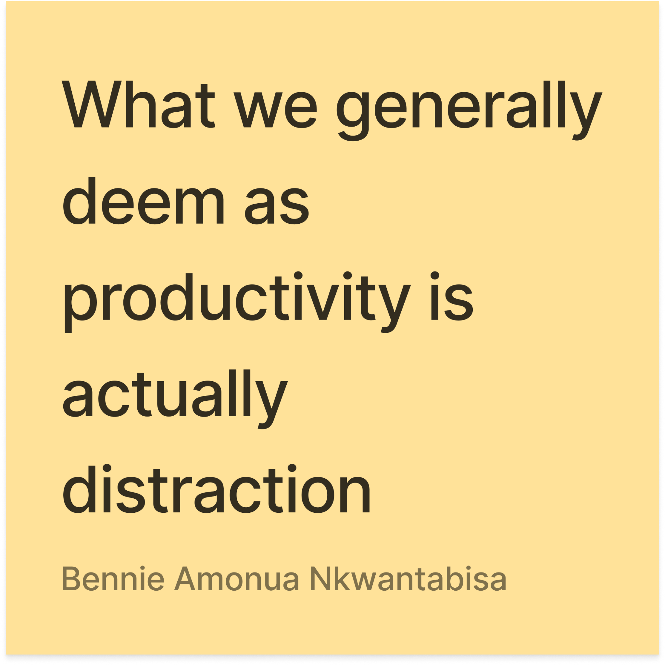
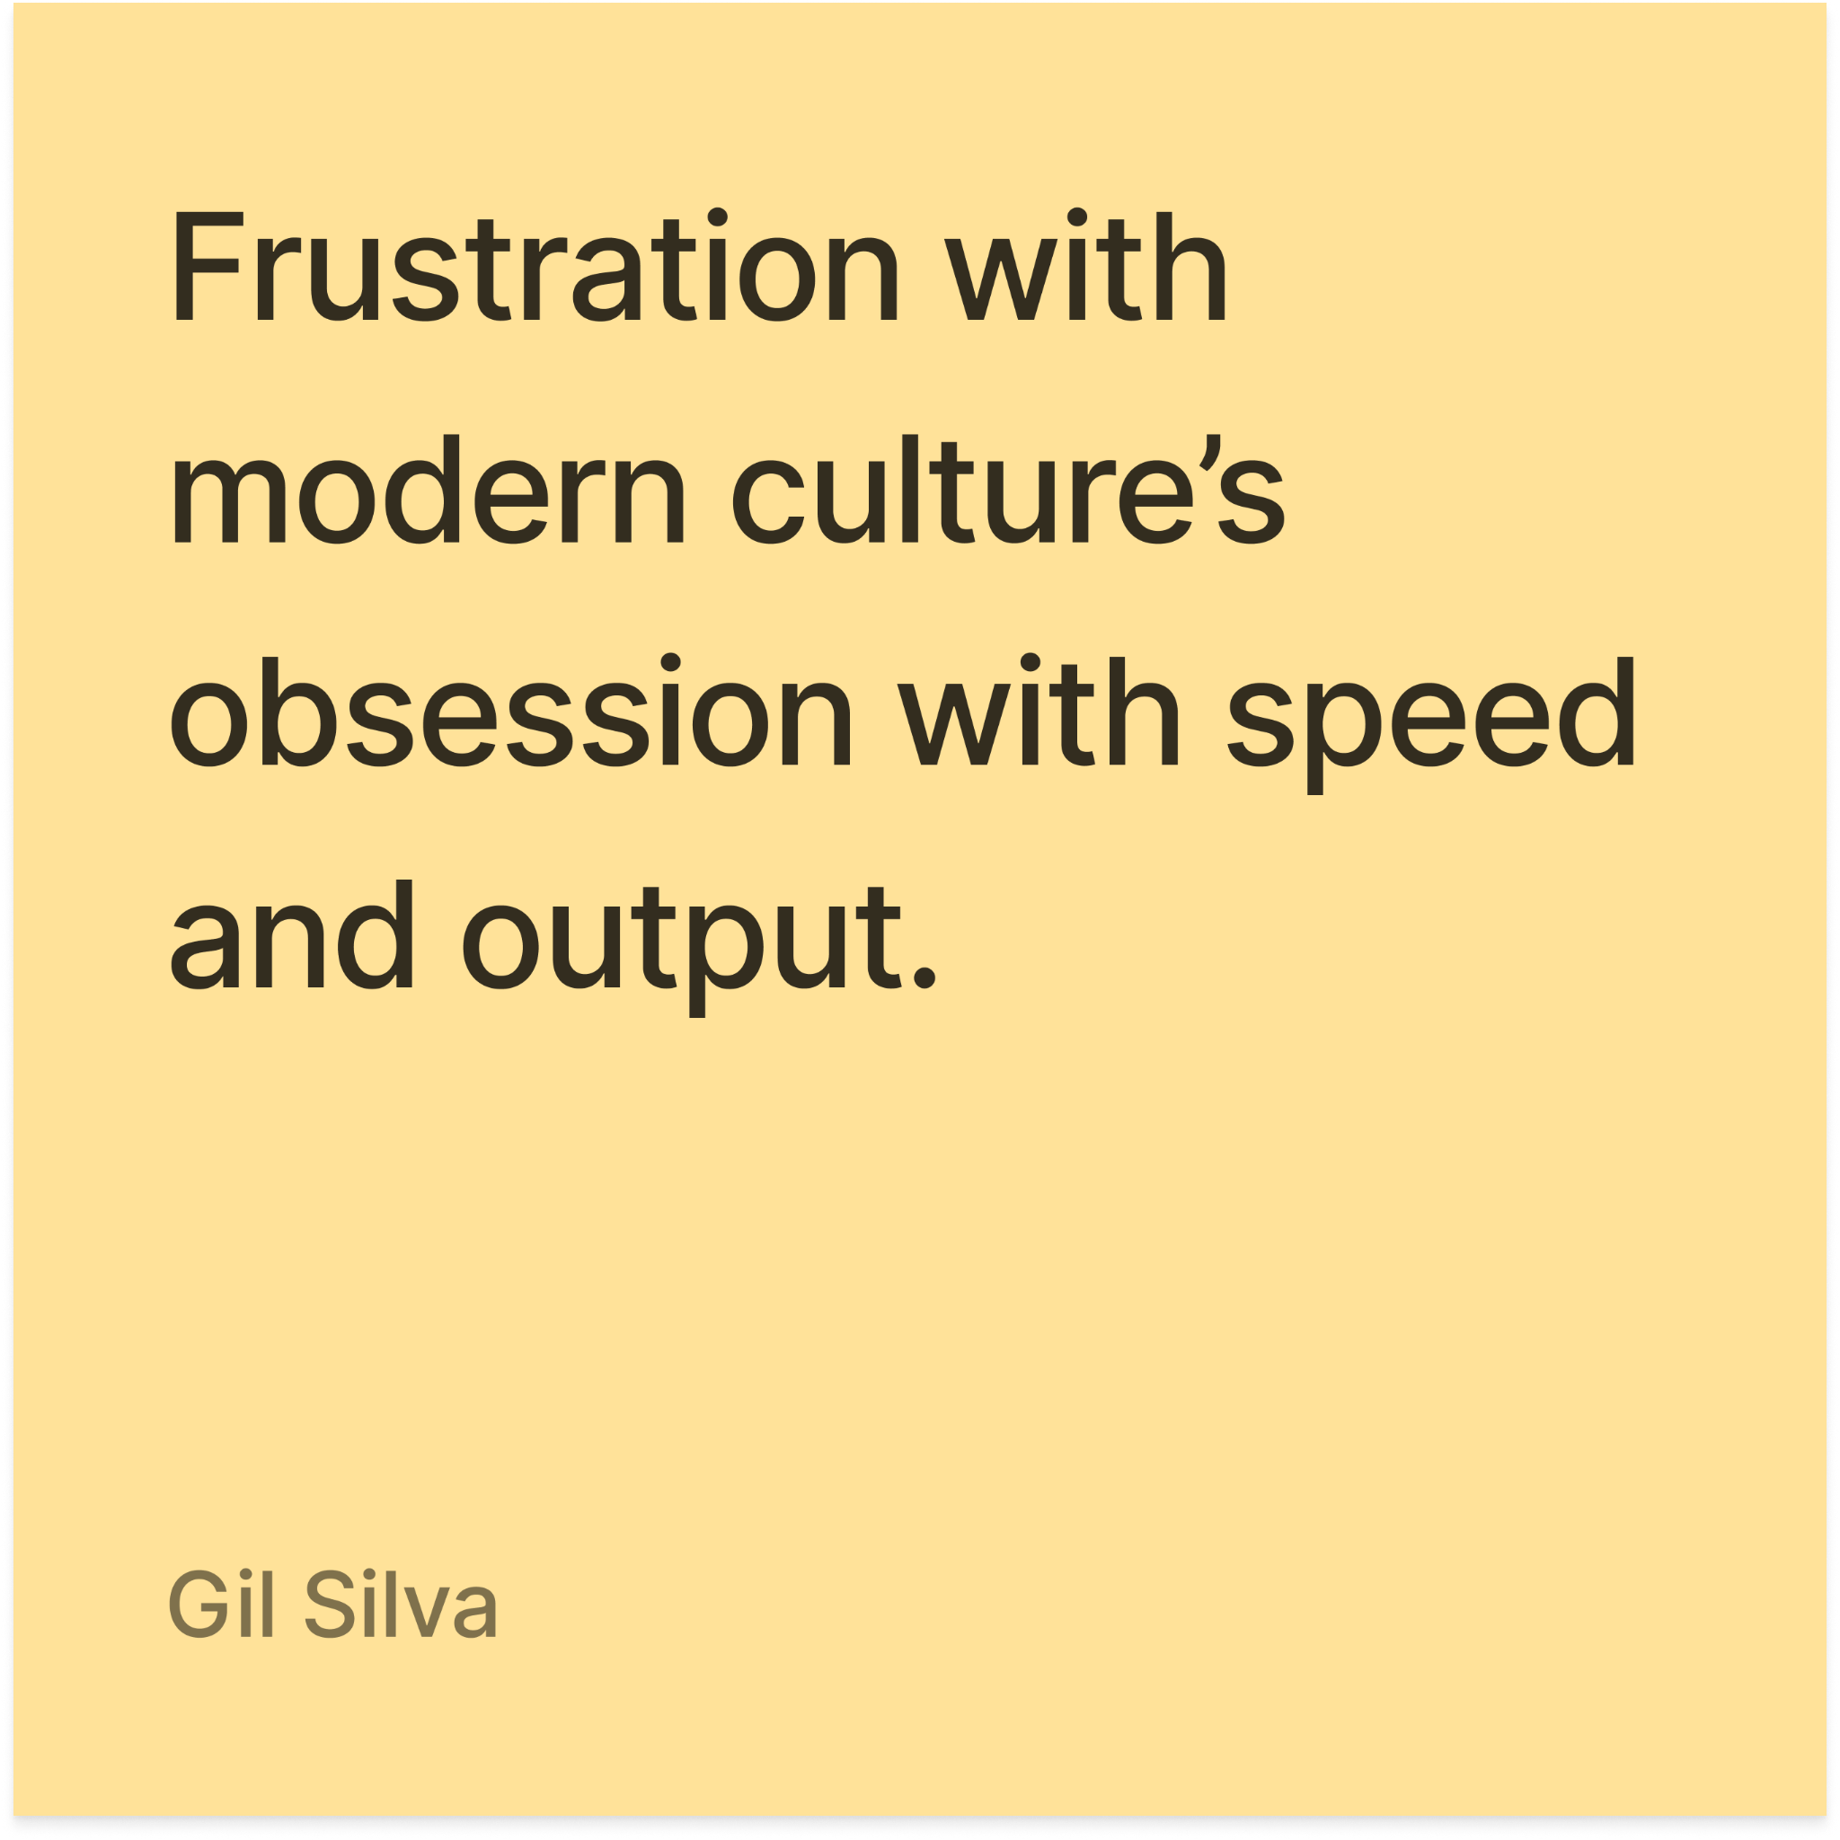
EMPATHY MAP
Notes:
Collectivist nature from trad philosophy -> Incredibly old fashioned in pedagogy
Prod is uniformity + distraction
Critical of education rn vs his idea of the role
Against the system of output and money over learning/thinking

Slide 19
“I should be doing something but I’m just on my phone. I’m just taking a nap and I missed my assignment again.”
Barry
19, Sophomore @ Cal State University Monterey Bay

Slide 20
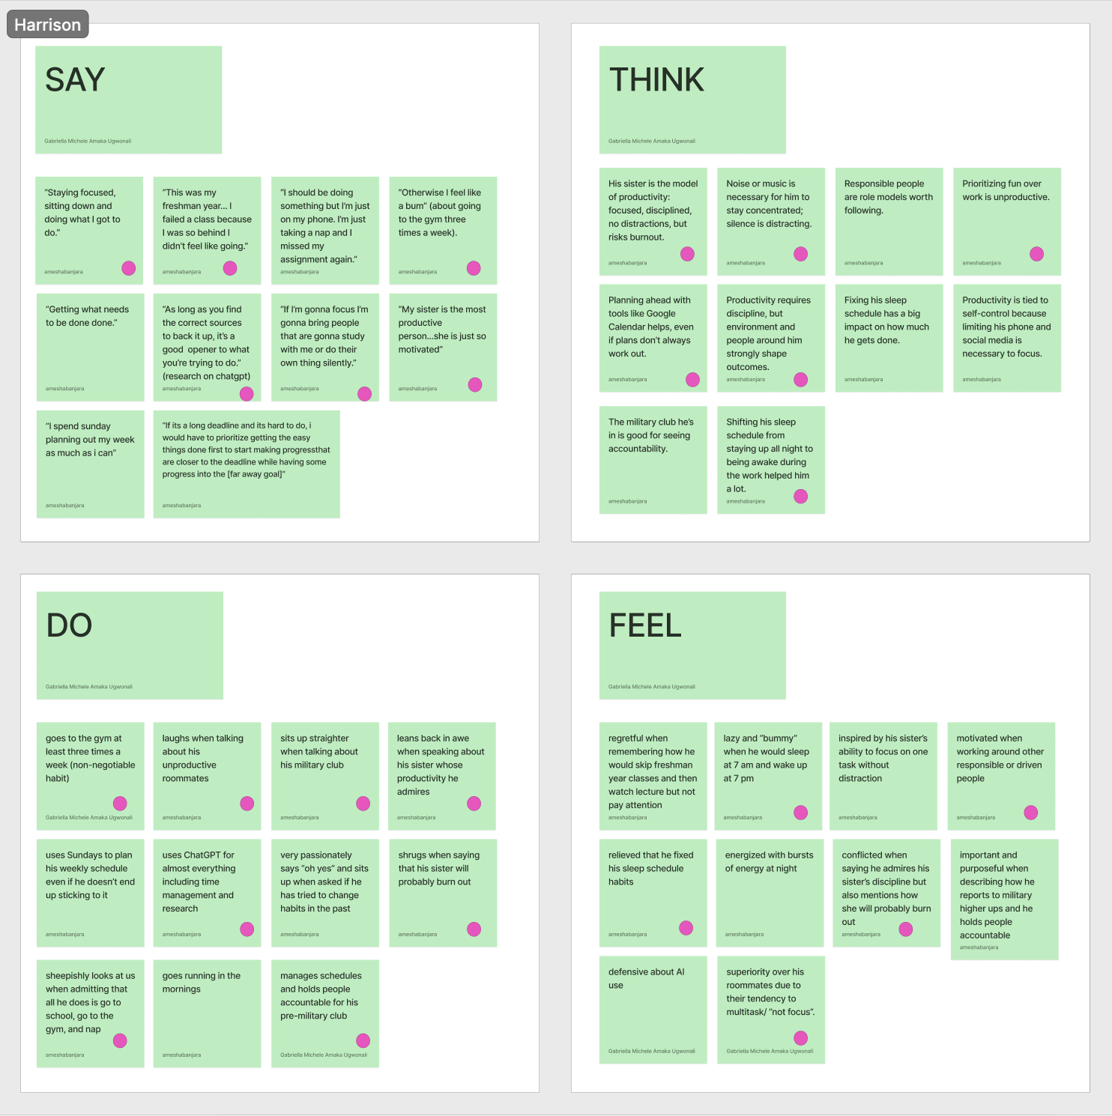
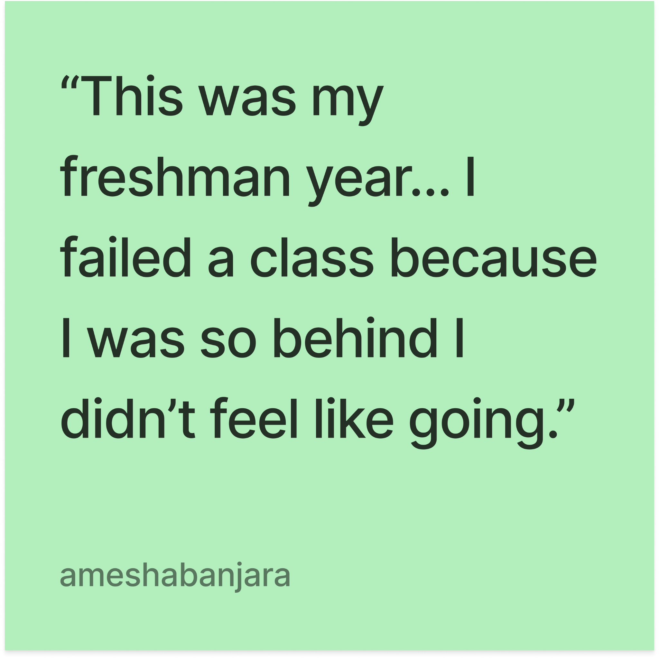
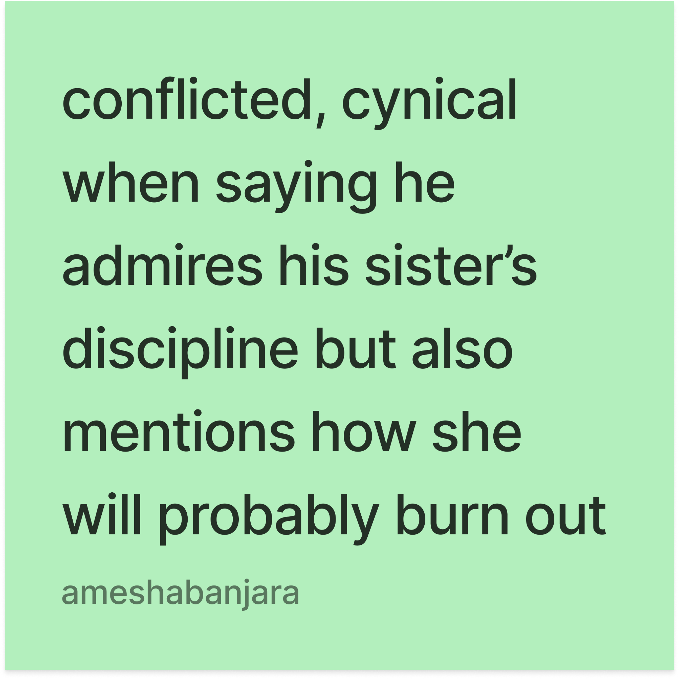
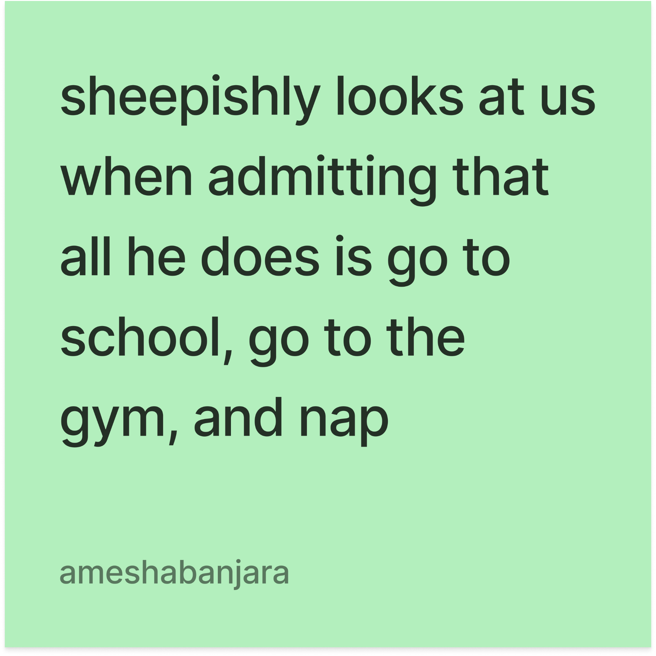
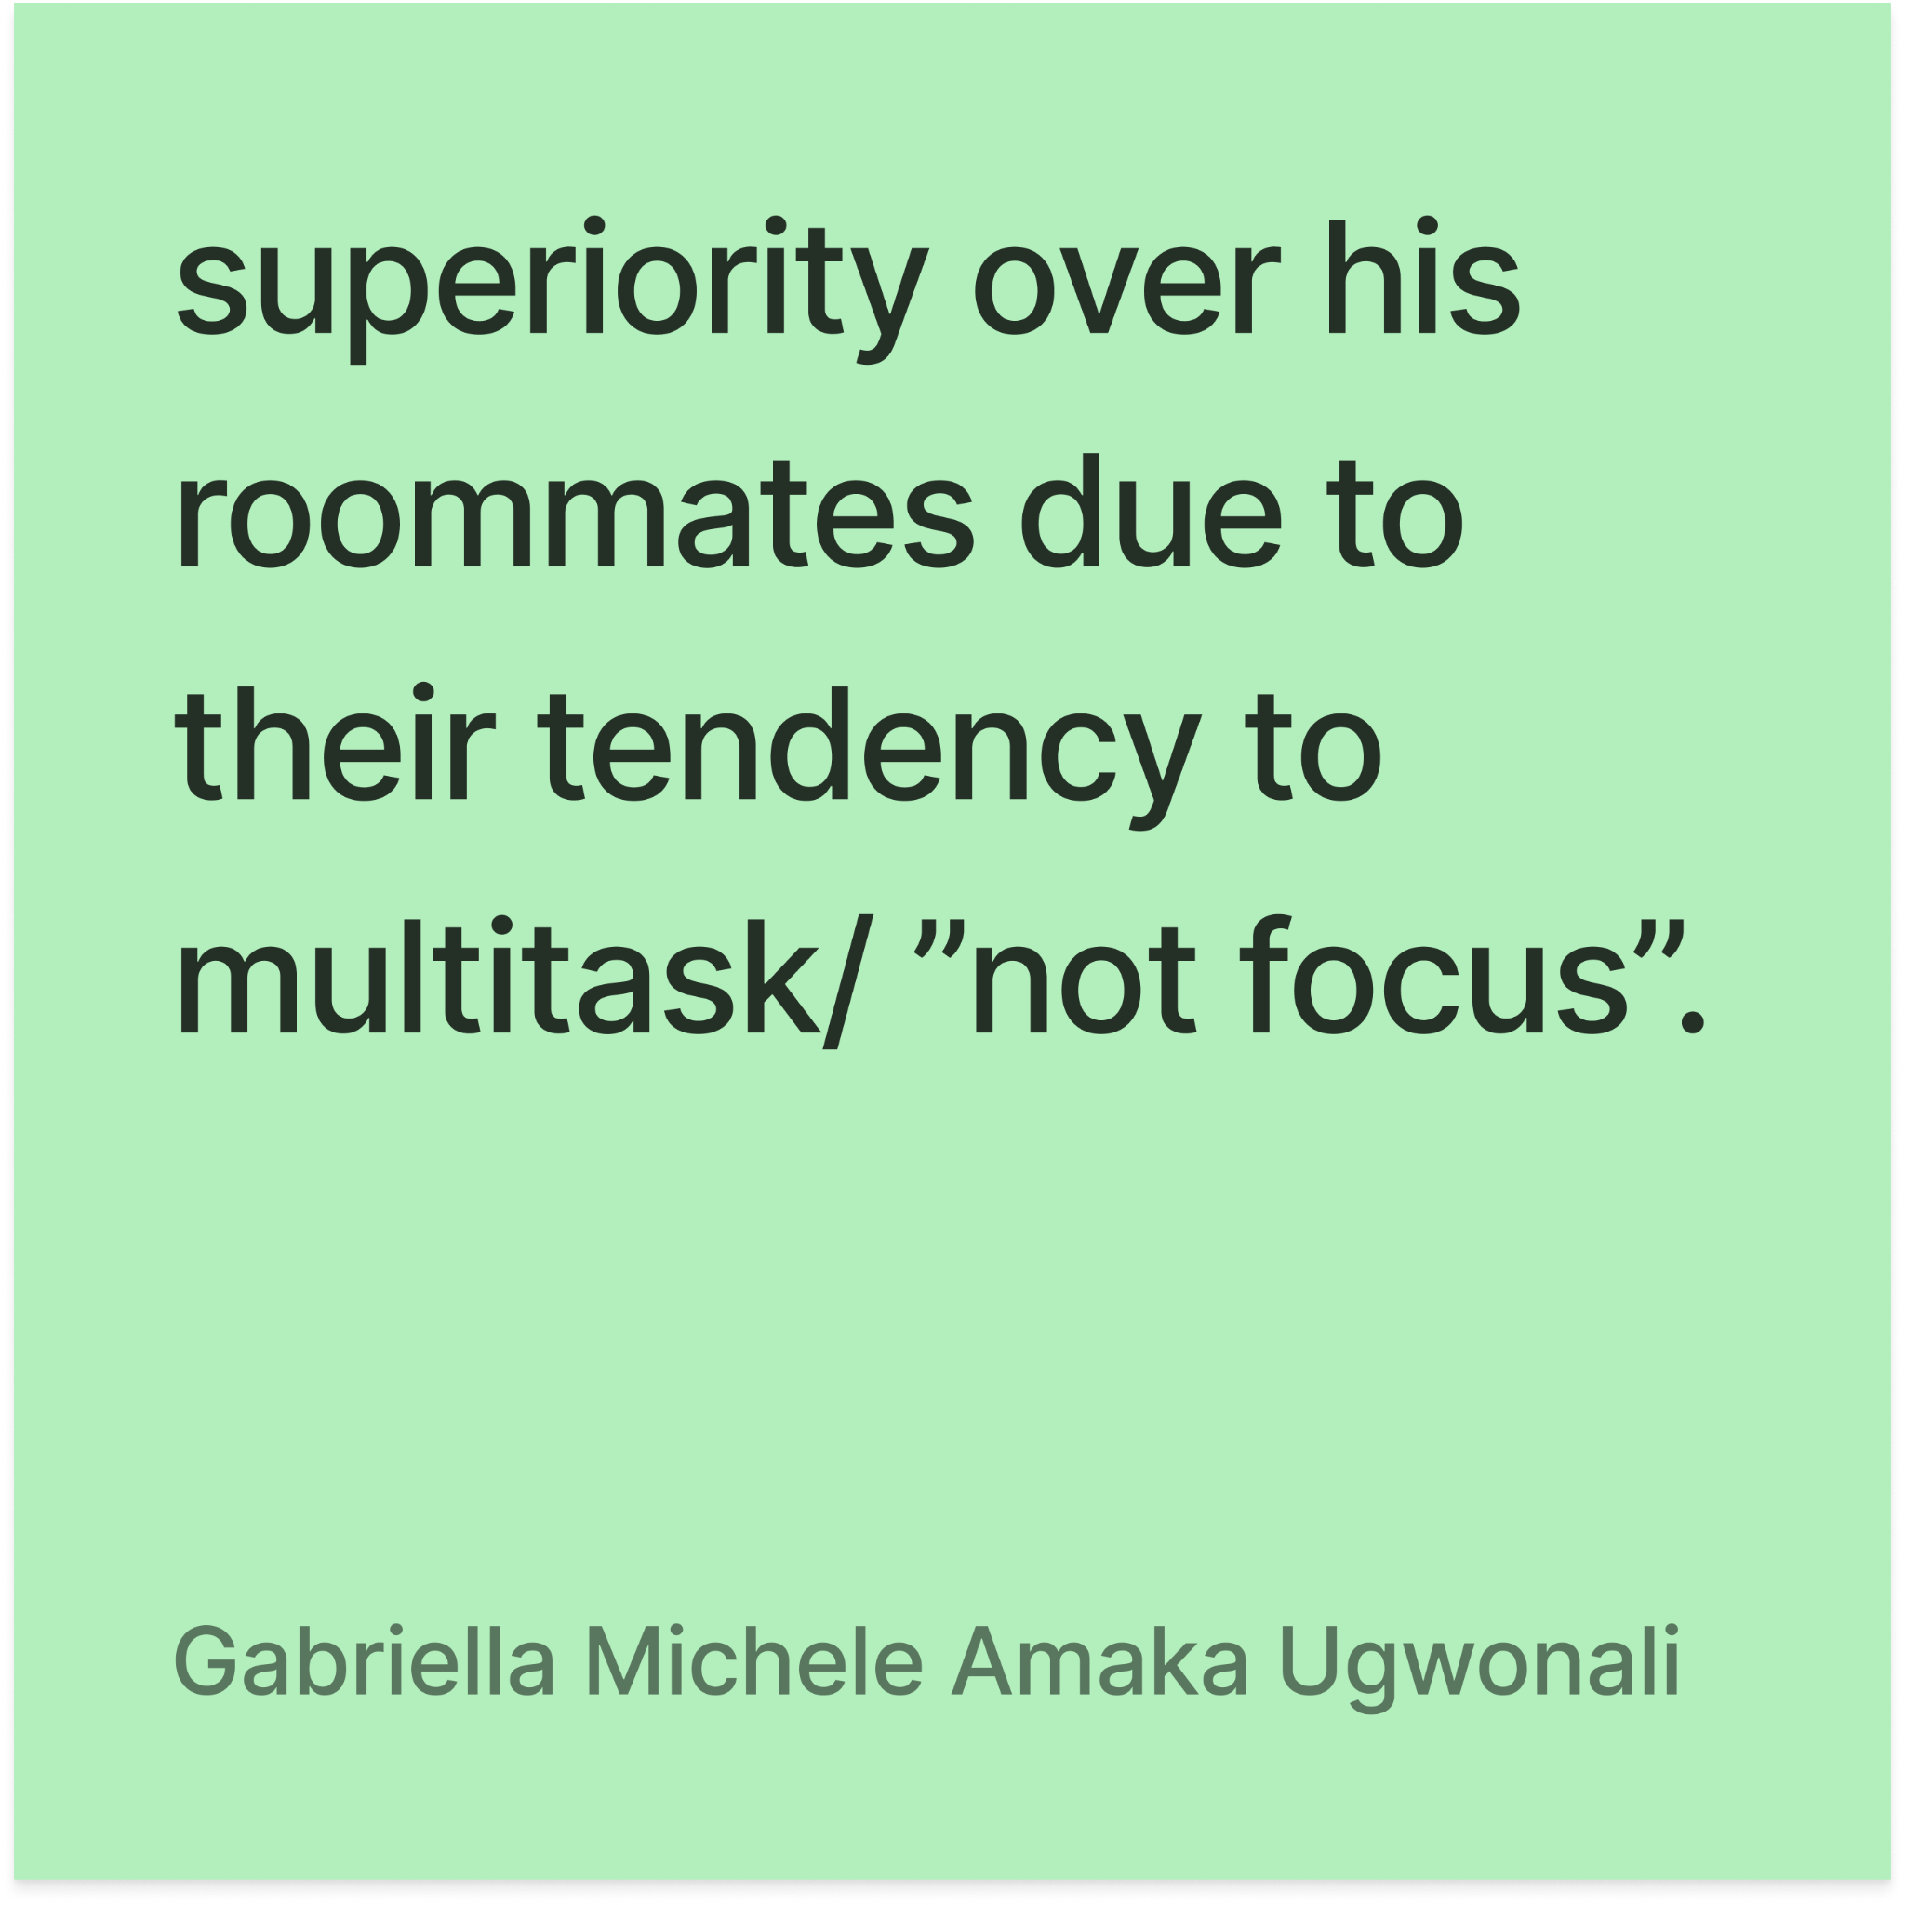
EMPATHY MAP
Notes:
Discipline
Prod is consistency, “getting done what needs to get done”
Air of self-deprecation (“fixing”)
Distance between him and his failures
Acknowledgement w potential lack of self-awareness
defensive + justifies AI usage, inferred guilt
His model of motivation is more distant than like day to day
Views on sister productivity is more cynical than caring

Slide 21
“It feels good to be lazy, I’m gonna be honest.”
Seth
15, Sophomore @ Palo Alto HS, Student-Athlete

Slide 22
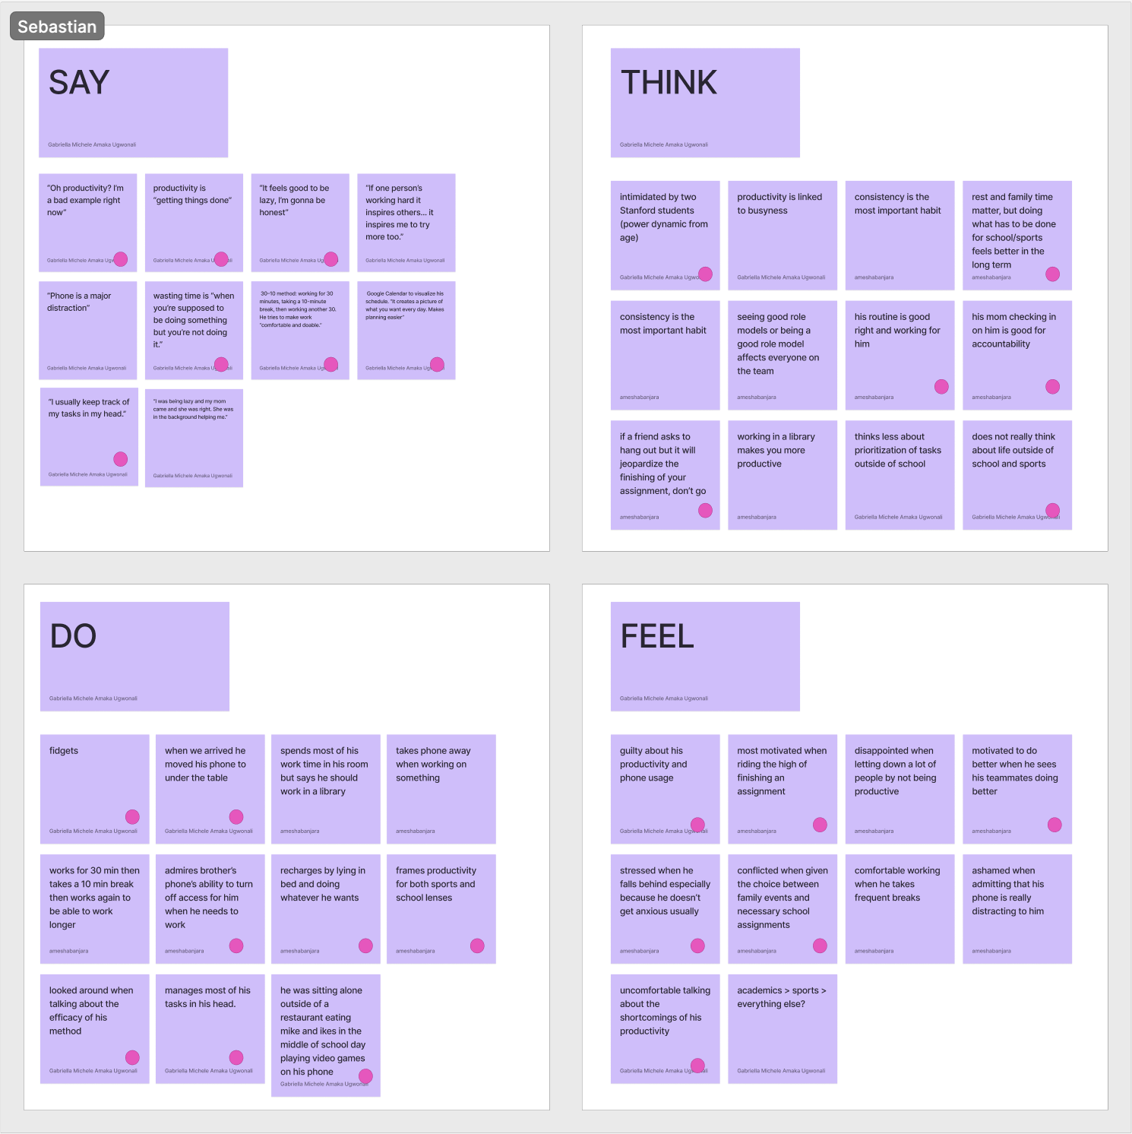
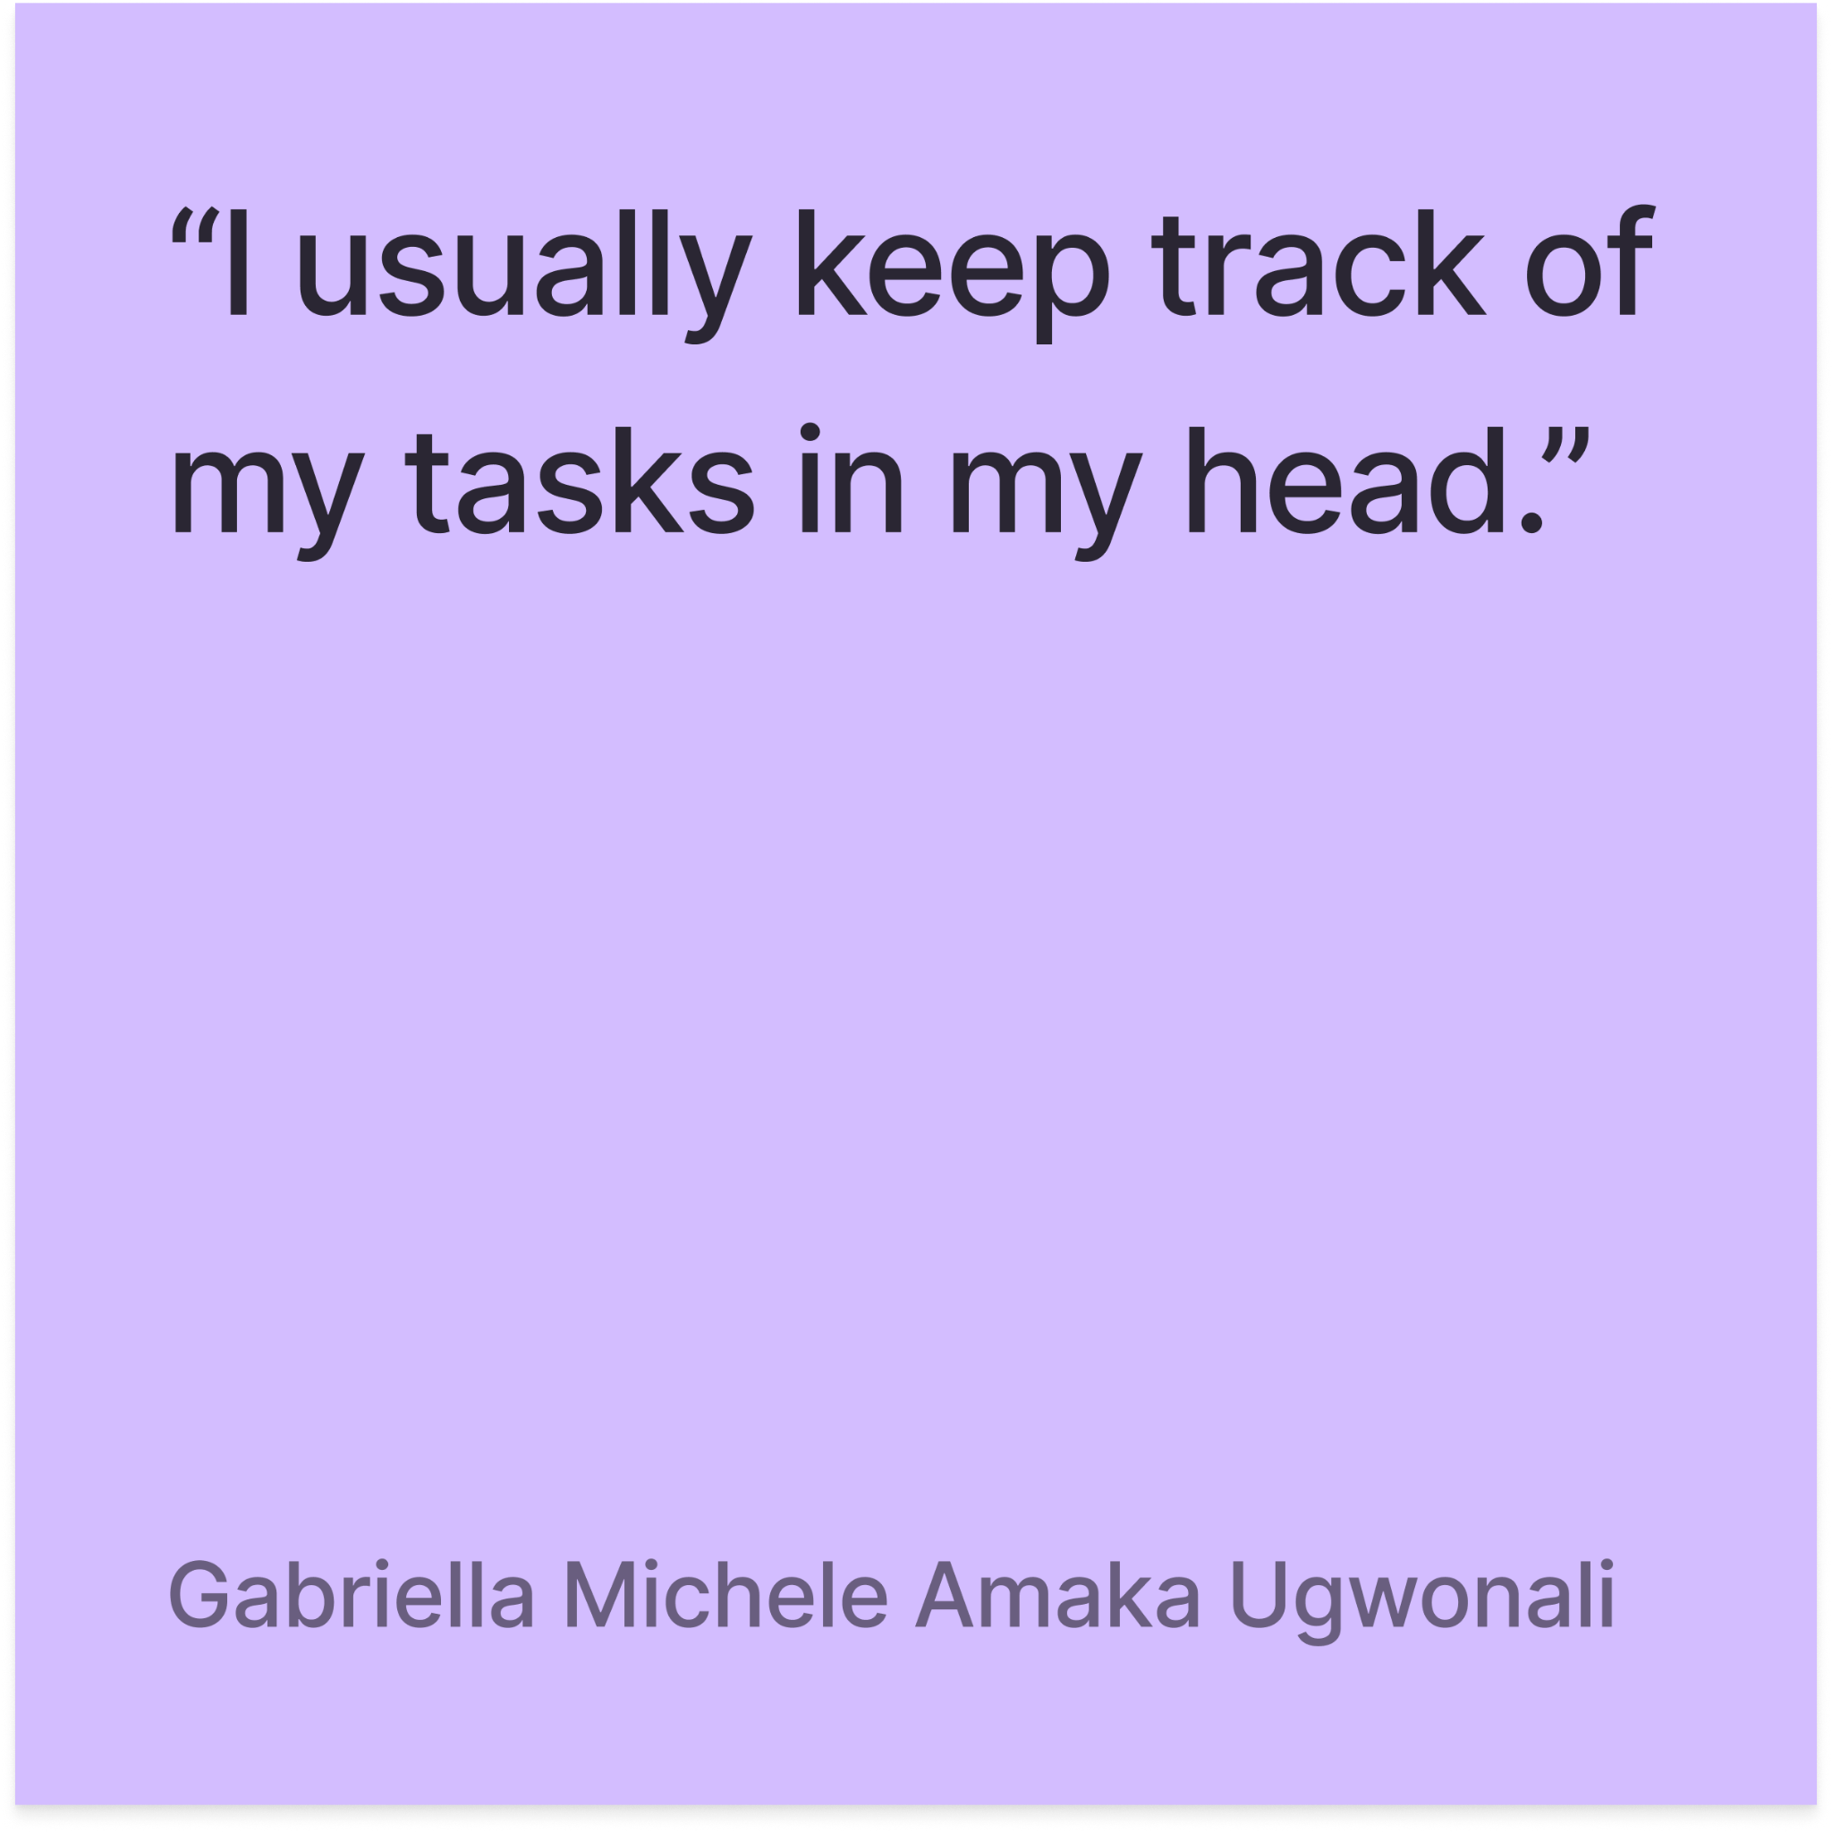
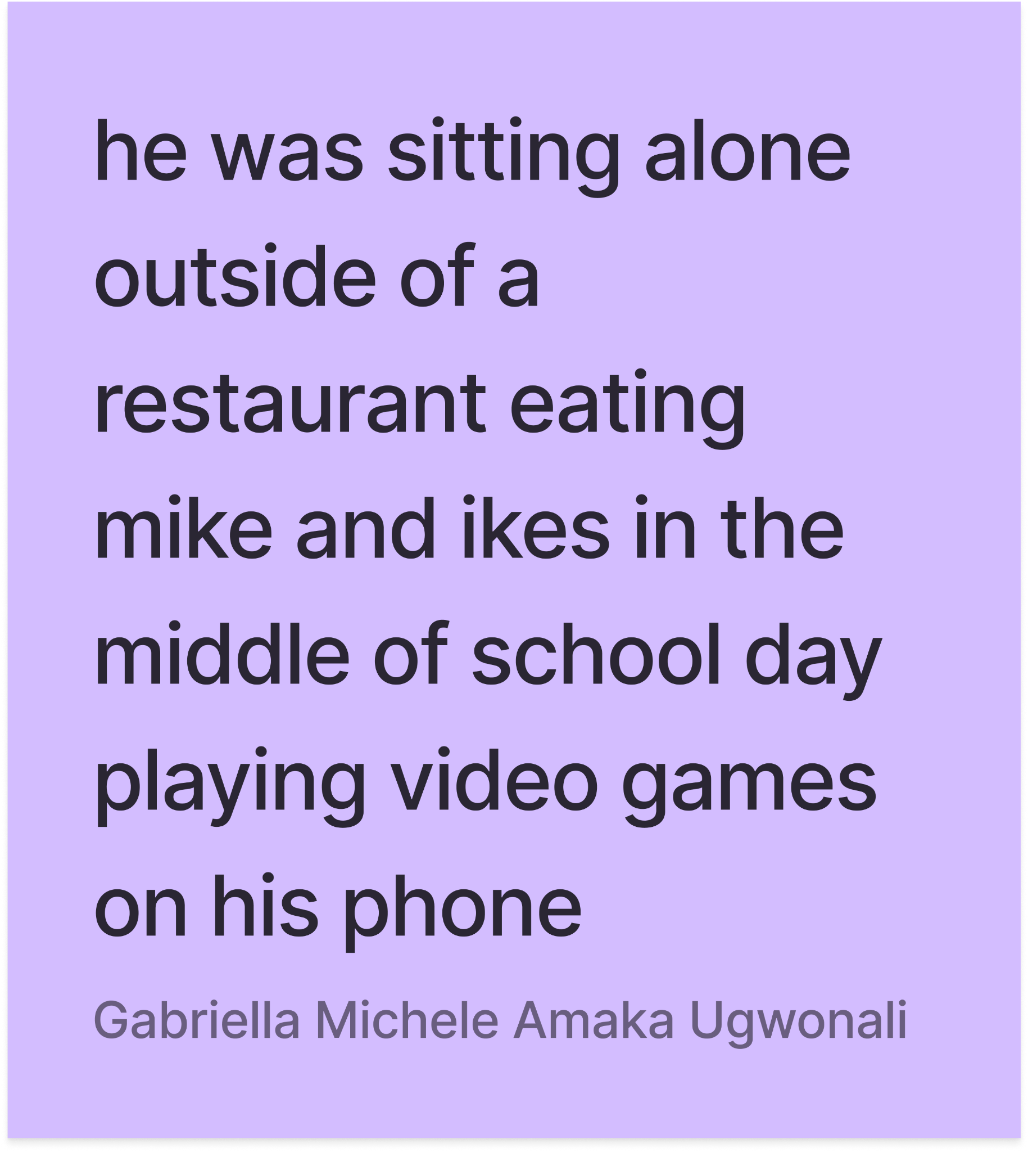
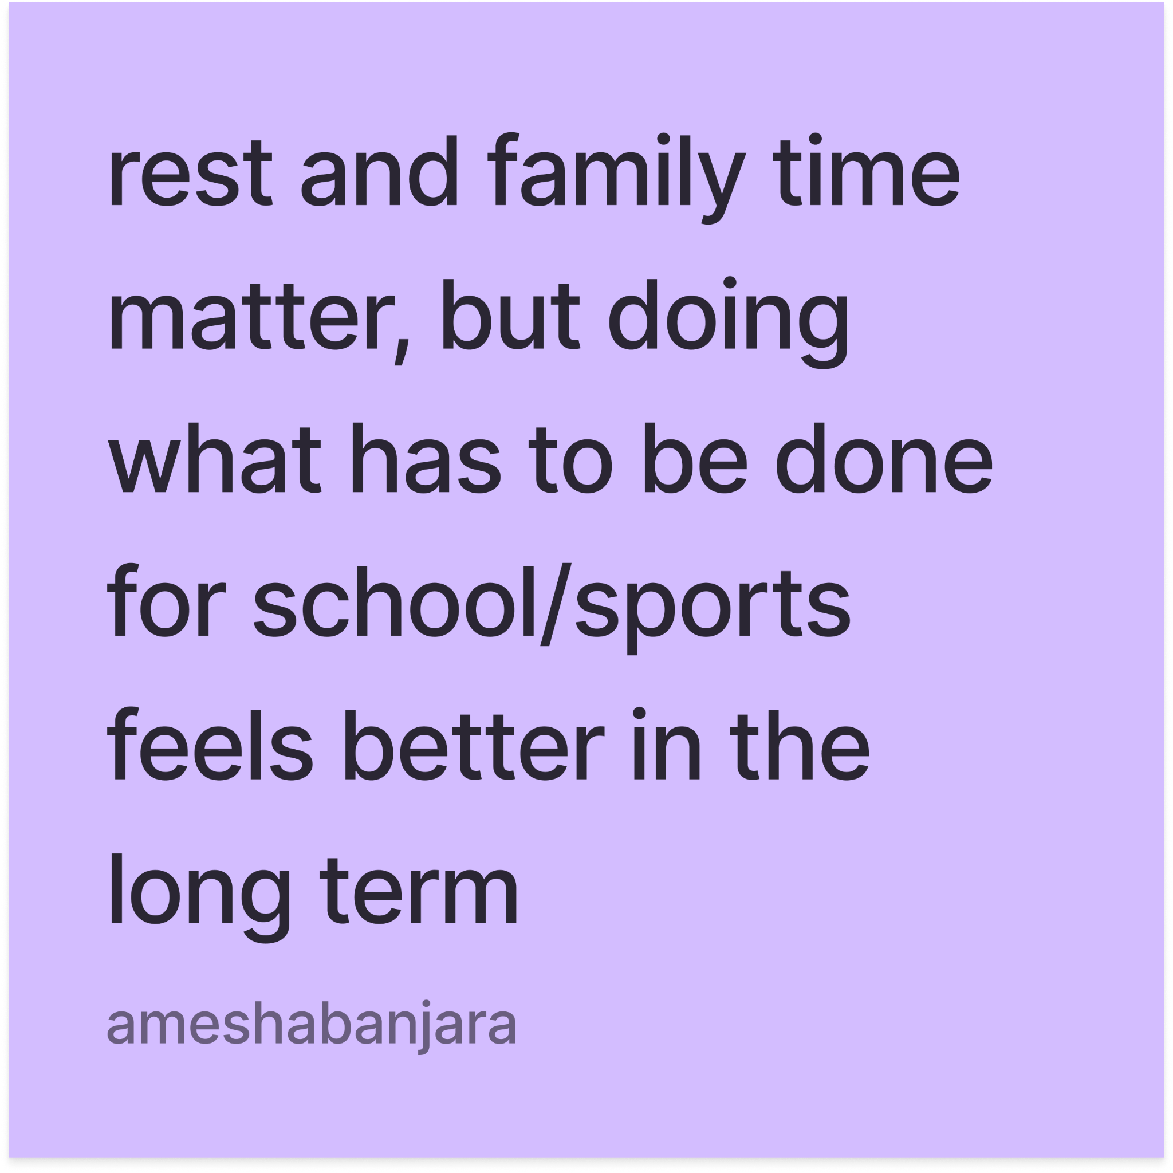
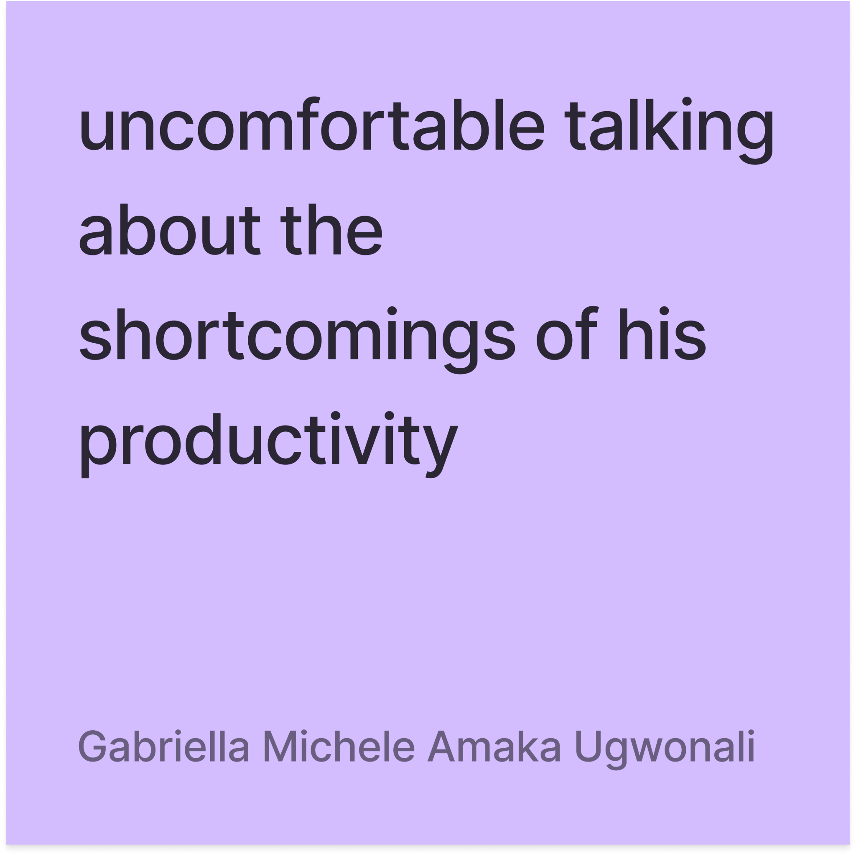
EMPATHY MAP
Notes:
He is genuinely a child AWWWW
doesnt prioritize socialization outside of classes and sports
Doesnt prioritize much outside of school or school related stuff
Seems to be lots of dissonance between what he says and what he does, almost as if he knows the “right thing to say”
You should ____, i usually ____
b&w view on prod: lazy, getting things done, bad example of it
Roles models instead of peers, very authority-focused
(intimidation), stanford girls, phone under table, fidgety
Tone of inspiration/influence from others doing well, but
Doesnt feel that friends are relevant enough to bring up in a conversation about productivity

Slide 23
“I work 15 or 16 hours daily. You only come home to rest from the day’s effort.”
Jamie
43, DoorDash Delivery, Ex-Colombian military

Slide 24
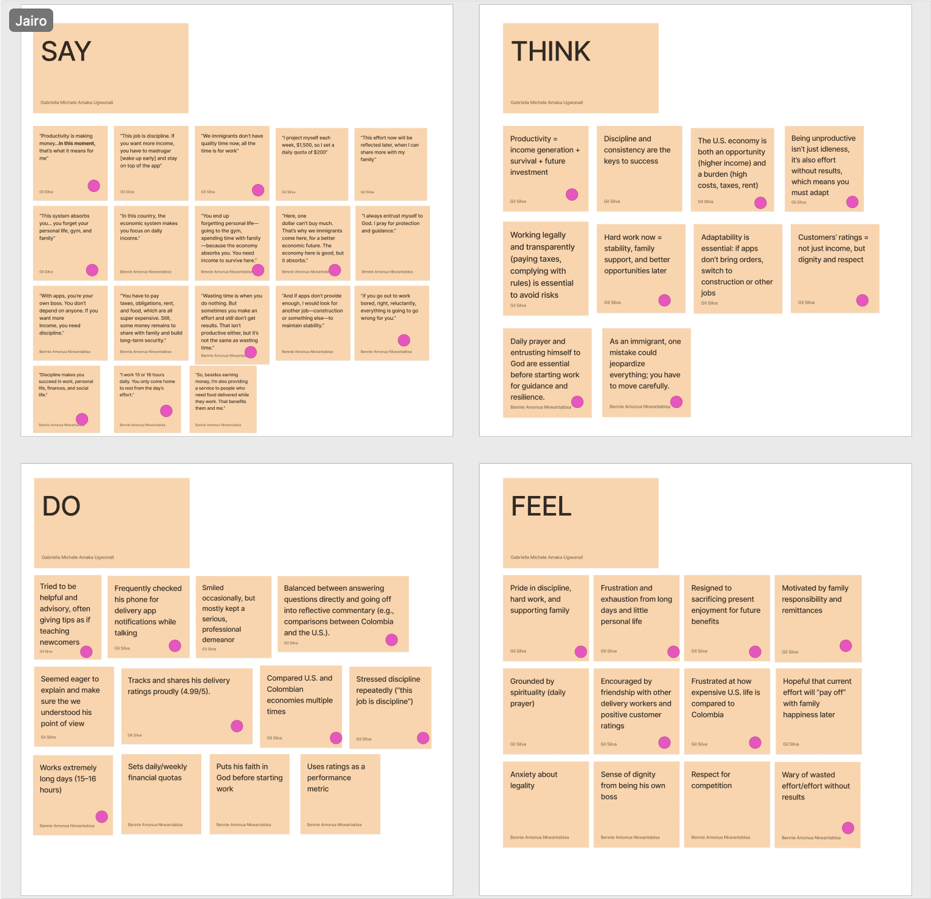
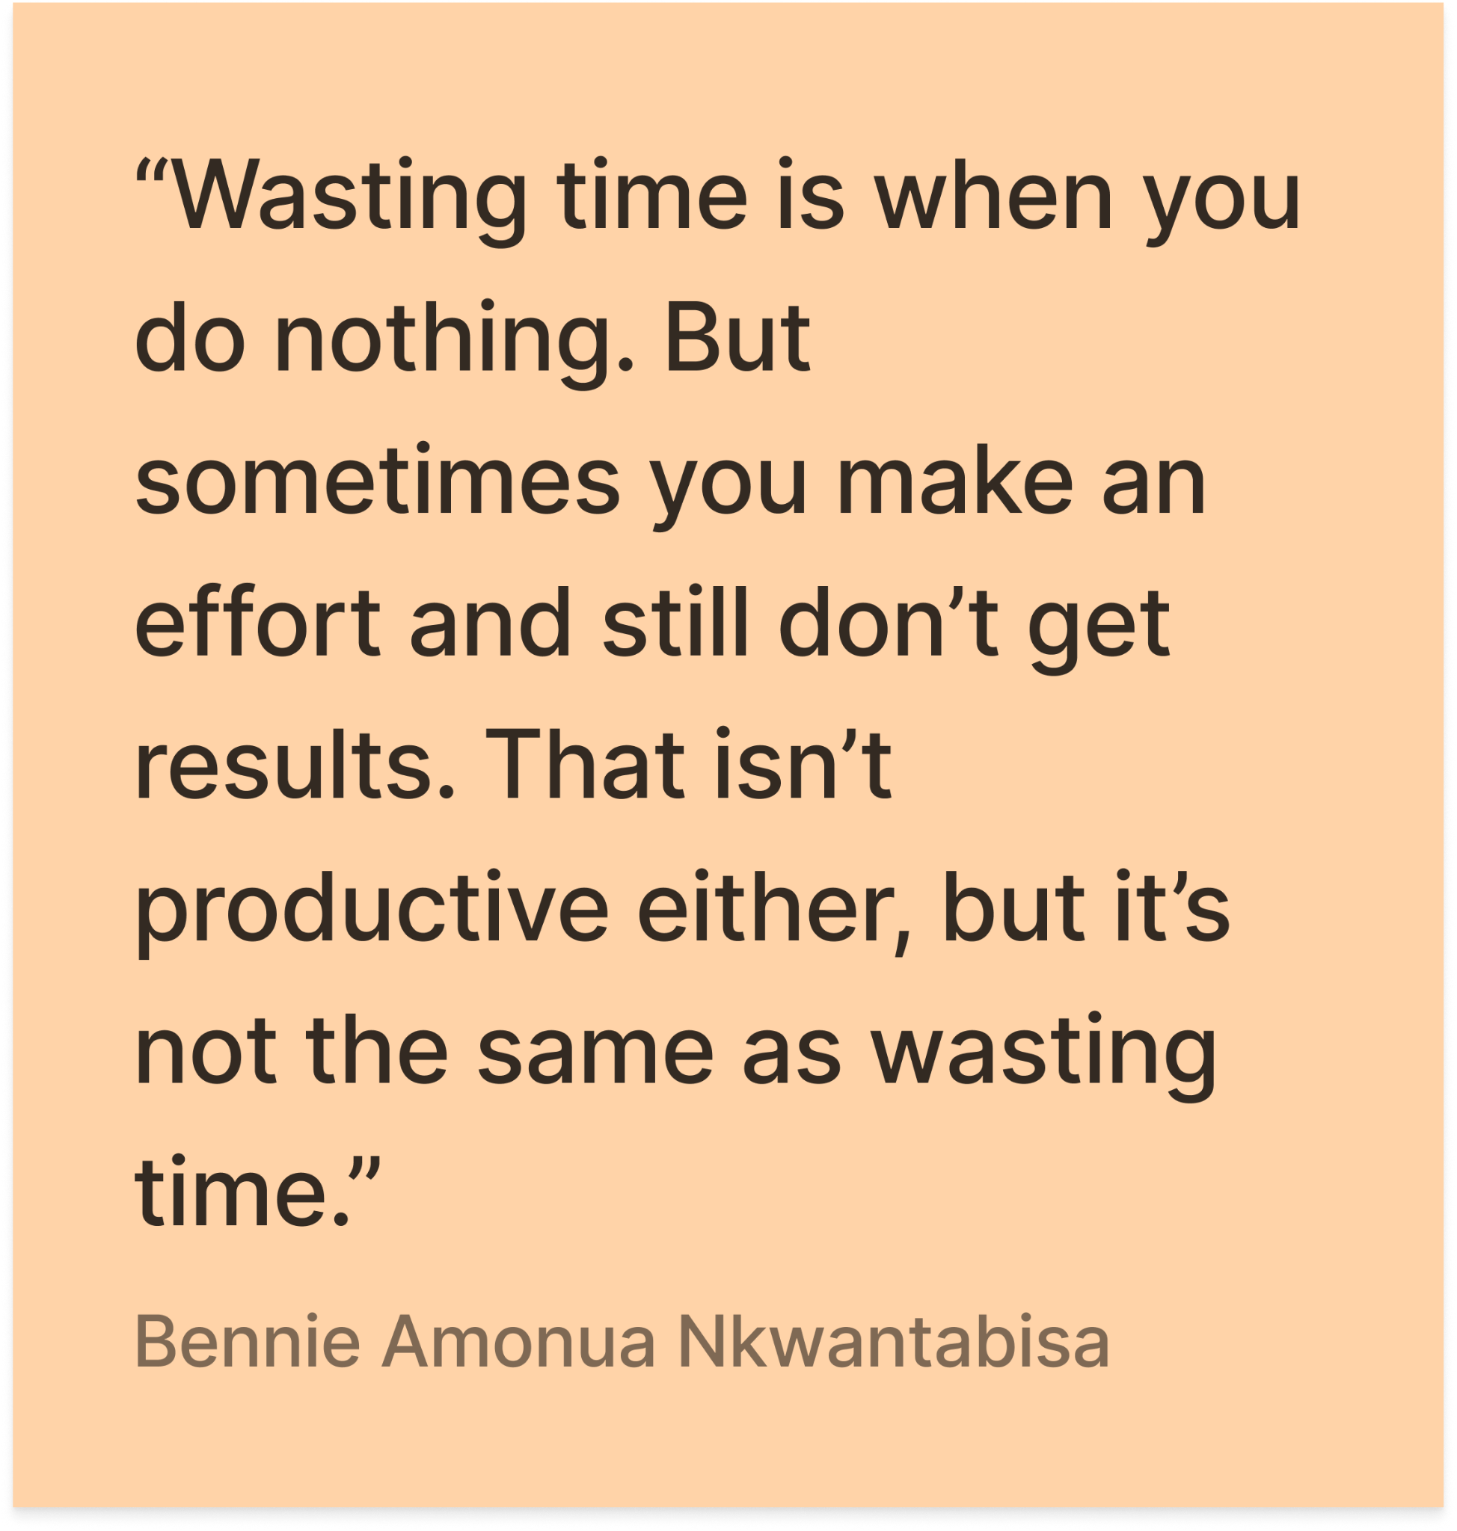
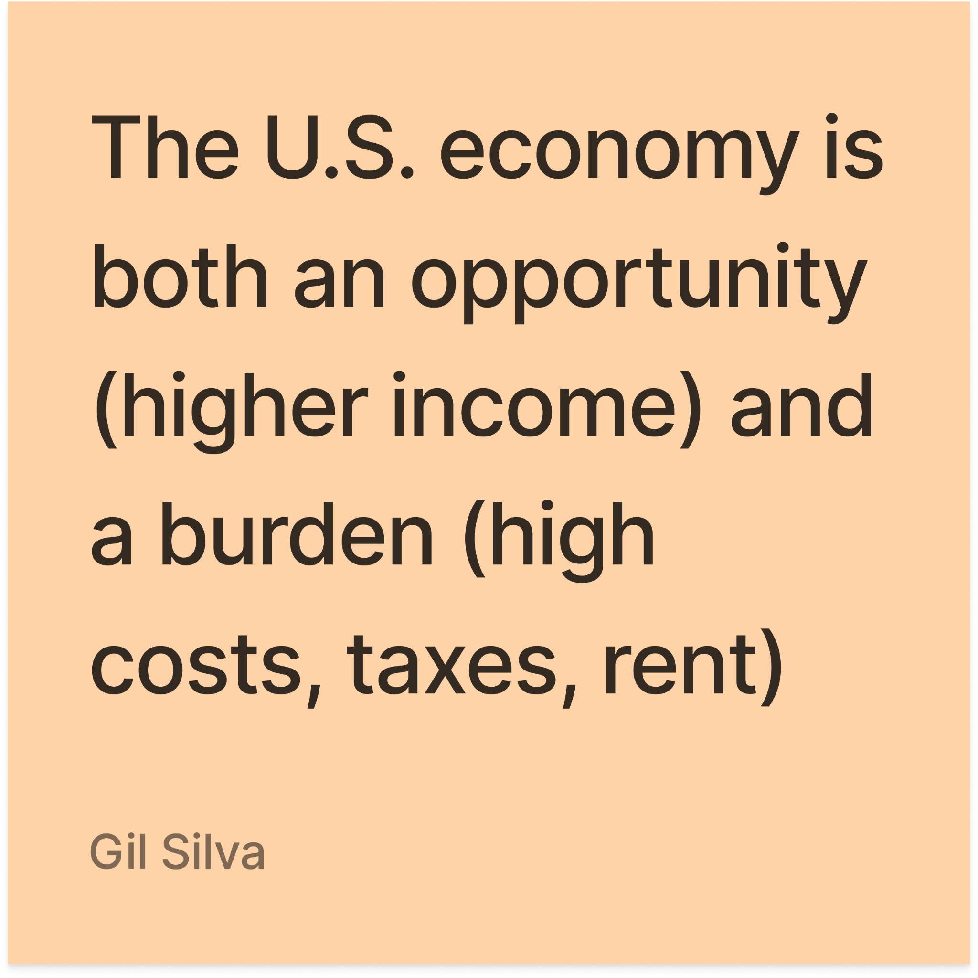
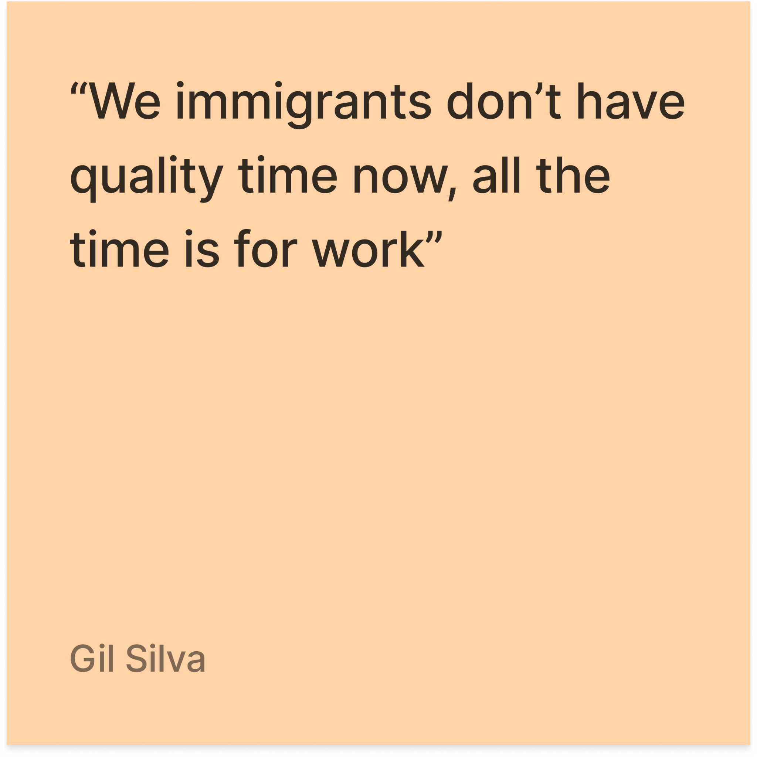
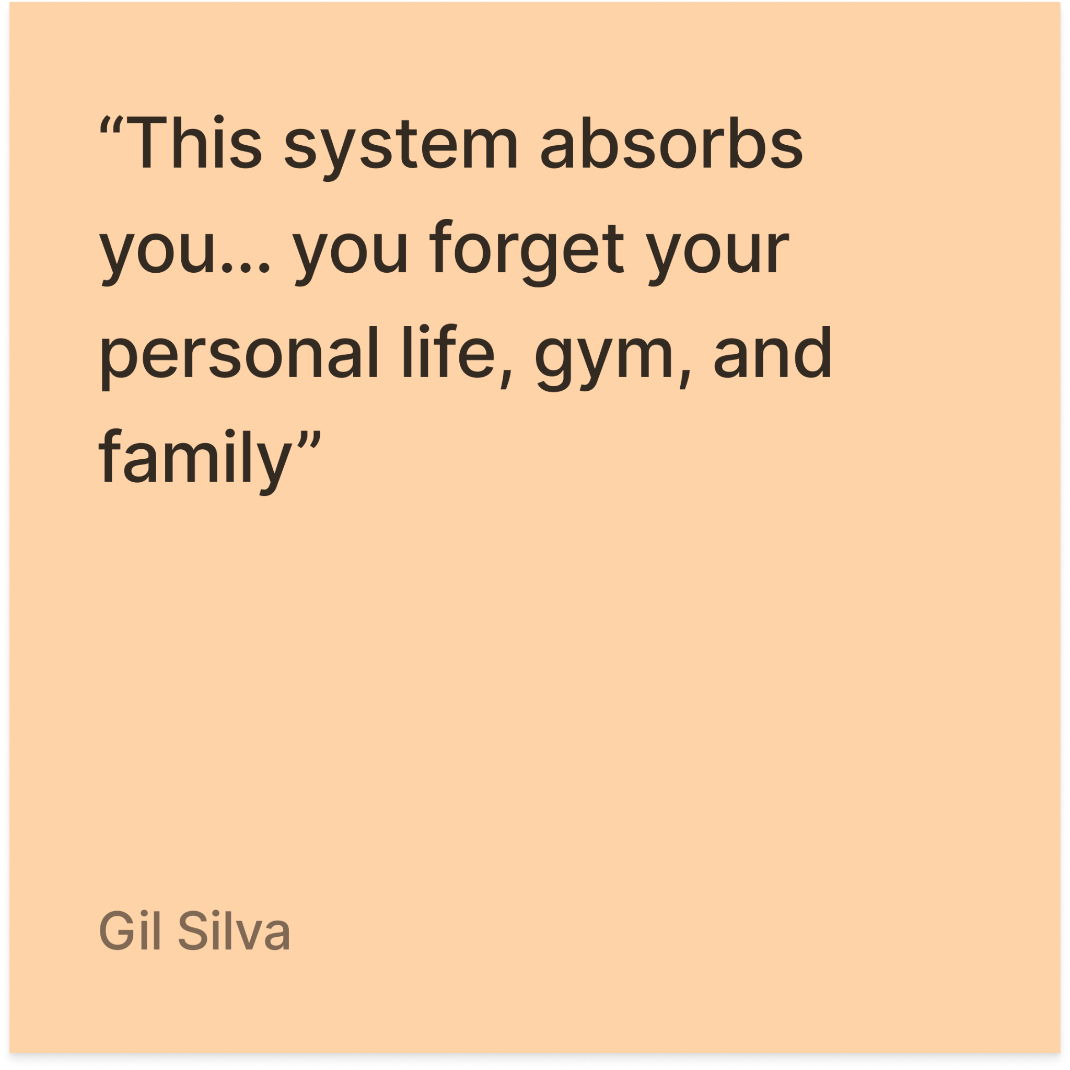
EMPATHY MAP
Notes:
Incredibly hard working
Sacrificial
Hope-centered
Fluid def of prod (rn money)
Immigrant p

Slide 25
TENSIONS EXAMPLES
Joy vs Guilt
JC views games as productive joy, Darci feels guilty when not producing
Structure as Freedom
vs
Structure as Pressure
Gabby uses routine to reduce anxiety, Jamie uses quotas that trap him into 16-hour days
Productivity as Survival
vs
Self-expression
Jamie needs it for money, Omar ties it to philosophy, Gabby to stability, JC to balance

Slide 26
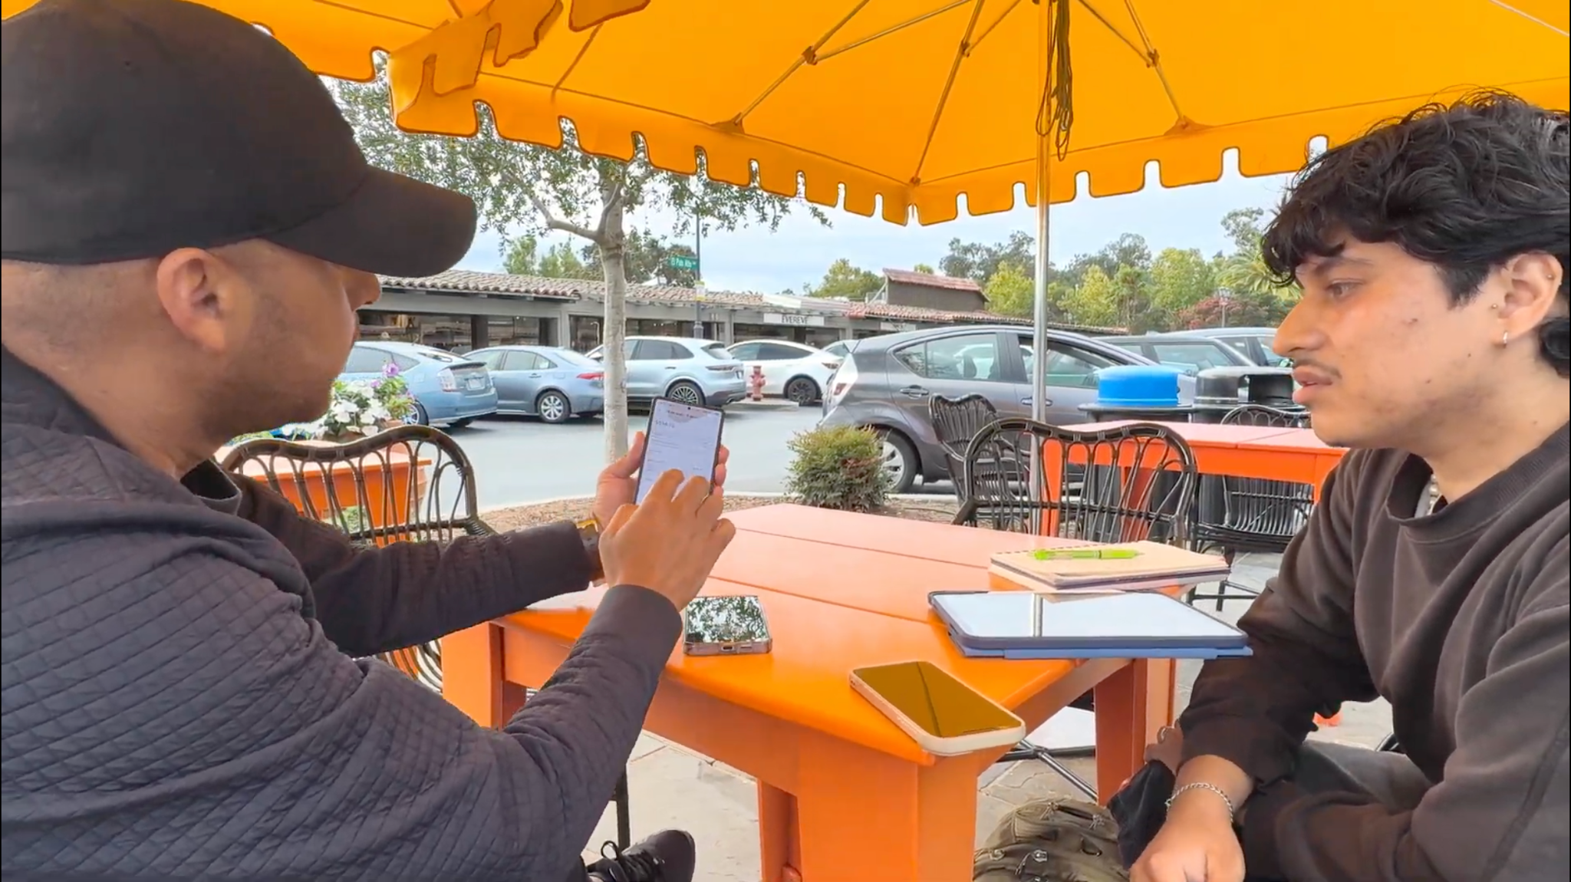

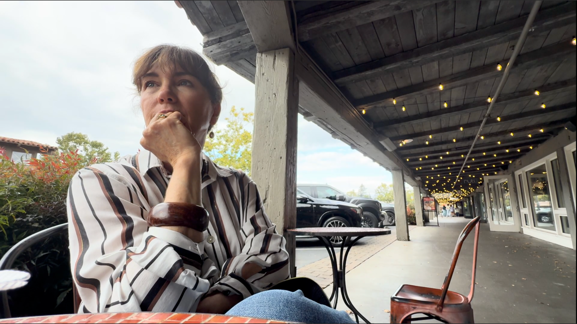
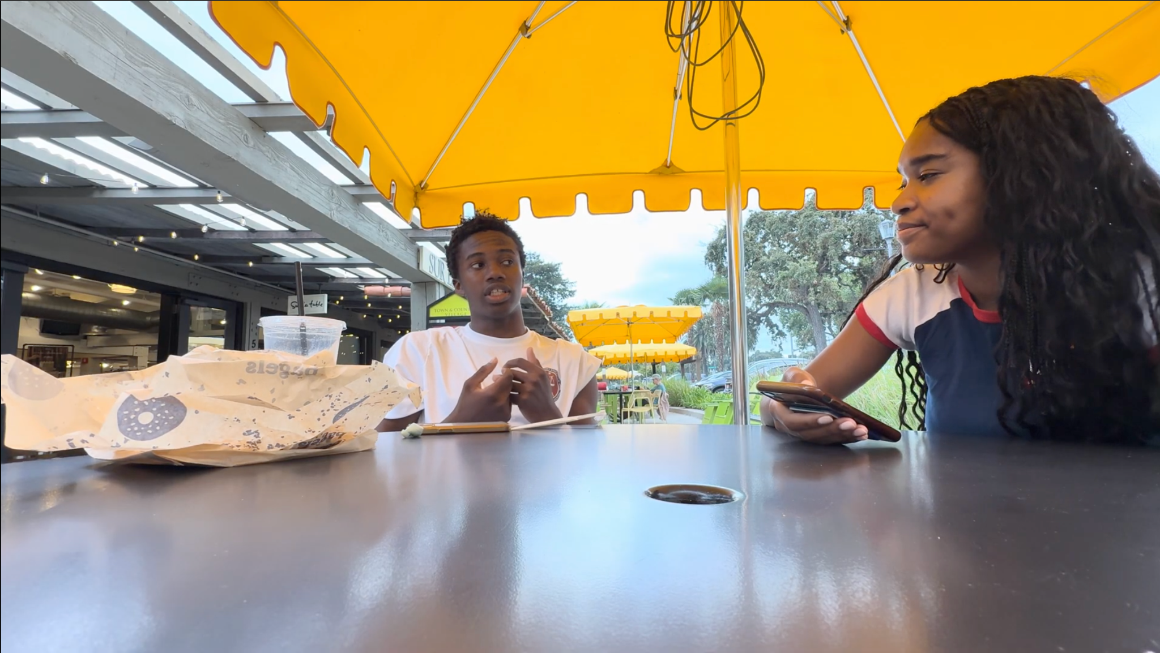
INTERVIEW FINDINGS
1. There are shared charges of emotionality when describing the role productivity plays in their lives.
Anxiety, shame, pride, dignity, guilt; there was no neutrality.
2. Structure and ritual are not just used to manage time + tasks; they also regulate mood + identity.
Calendars, lists, quotas, prayer, exercise routines all fulfilled a deeper purpose of providing regulation.
3. Interviewees felt that productivity is supported by ambient accountability.
From body doubling to healthy competition to caregiving, productivity thrives as a result of being around others/social presence.
4. Interests are seen as a necessity to some and a luxury to others.
Some felt that exploring interests and hobbies was an integral part of being human, while others felt it was time only some can afford.
5. Each person’s perception of “wasted time” is the negative image of how they perceive productivity overall.
What counted as ‘wasting time’ perfectly mirrored each person’s values: for students it was weakness, for workers survival risk, for caregivers misunderstood rest, and for thinkers loss of depth.

Slide 27
INSIGHTS + NEEDS
Each person’s perception of “wasted time” is the negative image of how they perceive productivity overall.
FINDING
INSIGHT
NEED
People’s deepest fears about wasted time reveal what they hold sacred; wasting time is powerful because it directly threatens identity.
People need ways to reframe and protect their time so it feels aligned with their values instead of threatening their sense of identity.

Slide 28
INSIGHTS + NEEDS
People don’t just use structure and ritual are not just used to manage time + tasks; they also utilize them to regulate mood + identity.
FINDING
INSIGHT
NEED
Structural tools provide psychological safety. They give people a sense of control in uncertain environments, turning productivity into a stabilizer for both mood and identity.
People need rituals and systems that adapt to their emotional state, not just their task list.

Slide 29
INSIGHTS + NEEDS
Productivity is supported by ambient accountability and is best under the influence of of varying levels of presence.
FINDING
INSIGHT
NEED
Being around others transforms productivity from an individual struggle into a social contract. Presence, whether through body doubling or shared labor, externalizes discipline and validates effort.
People need accessible forms of social presence that make accountability feel natural, supportive, and motivating without judgment.

Slide 30
SUMMARY / NEXT STEPS
We spoke with 7 people — high schoolers, a Stanford student, a scientist, a gig worker, a mom, and more — to understand what productivity really means in their lives.
Productivity is strongly tied to identity. It is shaped by emotions (anxiety, guilt, pride), values (family, meaning, joy), and culture (American individualism vs. collectivism traditions).
Next Steps:
Turn these needs into POV statements, HMW questions, and prototypes for A2!

Slide 31
THANK YOU!

Slide 32
Appendix
We could put consent forms, anonymized screen grabs of recordings, things li

